Slide 1
Kentucky Health Benefit Exchange
2017

Slide 2
Agenda
Welcome
Transition Update
Education and Outreach Role of Agents and Assisters
Landing Pages/Websites
Training/Resources
HealthCare.gov Processes
Q & A Discussion
KHBE
Kentucky Health Benefit Exchange

Slide 3
Transition Update

Slide 4
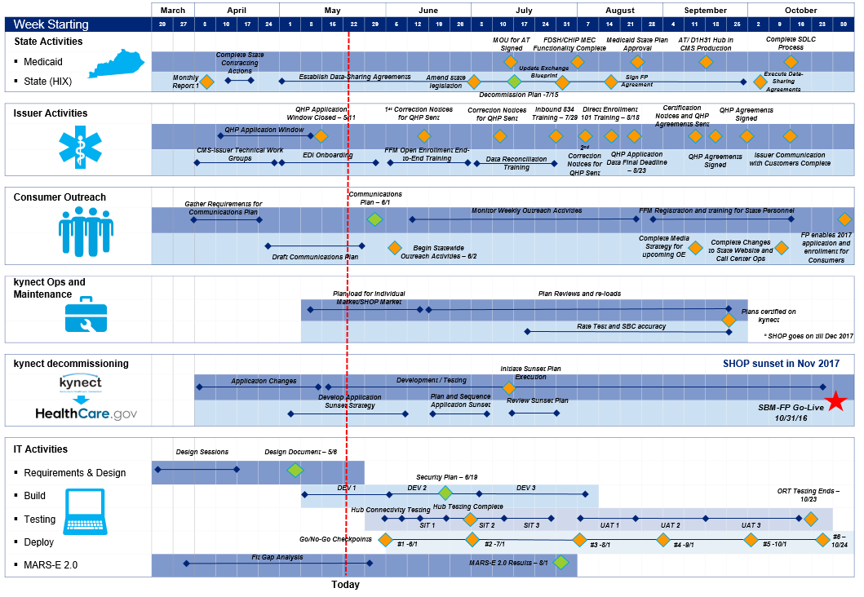
Kentucky SBM-FP Overall Timeline
Notes:
Review the timeline. (Note to ignore red line, was in place for a pervious meeting) This is the overall timeline up to go live a

Slide 5

Transition Update
Key Transition Milestones
Plan certification
Connectivity testing
UAT Testing
Regression Testing
Training
Client Lists
Education and Outreach
KHBE
Kentucky Health Benefit Exchange
Notes:
UAT Testing has gone well. Kynectors Sept 13th and 14th . UAT continues through 10/23. Feedback from UAT testing is logged for system fix. UAT testing provided a lot of feedback and there will be a Q and A document or quick reference guide that is being worked on. Also, Deloitte took feedback for some wording changes. Example that was given was that there was no clear indication in the benefind system when an application had been transferred to the FFM (other than eligibility status) so they are working on how they can implement something for this.
Regression testing is to make sure the system continues to work as expected.
Changes/fixes will be implemented based on feedback from testing
Future Milestones: implement IT changes as indicated by testing, checkpoints for IT functions leading up to 10/31 go live.
Training and consumer messaging are also included in Future milestones. We will discuss each topic in more detail later in the day.
There is an Executive Summary Meeting mid September and an Executive Meeting early October to summarize and review KY’s readiness for the transition. Expected to go well.

Slide 6
Transition Update
October
Notices
Updated Marketing Materials distributed
Transition messaging began
Call center started transition scripting and special message on IVR.
KHBE
Kentucky Health Benefit Exchange
Notes:
Notices will go out first week in October, Updated Marketing Materials distributed, Transition messaging begins on social media and notices, FFM and our call center will begin transition scripting and special message on IVR.
Recently met milestones: plan certification and connectivity testing
Current/Future Milestones: Complete changes to state website (per testing), Training for stakeholders, Notices to consumers
OEP

Slide 7
Transition Update
October
November
January 2017
November 1, OEP begins
kynect.ky.gov website enables transition to healthcare.gov and benefind.ky.gov
Complete marketing materials distribution
Transition messaging begins on social media and notices
Call center workers begin transition scripting
Special message begins on contact center toll free line
Launch creative materials, in-field outreach efforts
start of kynect and FFM media efforts
January 31 2017 end of OEP
March 2017 Final transition with exception of SHOP
KHBE
Kentucky Health Benefit Exchange
Notes:
Message timeline

Slide 8
Transition Update
  Kentucky as SBM-FP
Kentucky will maintain a fully functioning website. Kynect.ky.gov will direct QHP, APTC and CSR eligible individuals to HealthCare.gov and Medicaid/KCHIP eligible individuals to benefind.ky.gov.
Kentucky will maintain the current call center to provide information and prescreen individuals for referral to either HealthCare.gov or benefind.ky.gov. Support Professionals and Tier 2 lines will still be available.
Kentucky will maintain the DCBS call center.
Kentucky Health Benefit Exchange will have an active staff to execute education and outreach plan, oversee the agent and assister program, process 1095 forms, manage SHOP Program and maintain a hotline for general information.
KHBE
Kentucky Health Benefit Exchange
Notes:
Will review landing pages later in the forum today.
Explain call center role for consumers, kynectors, agents
DCBS implementing a permanent task force at Mill Creek location in anticipation of OEP, the transition and beyond
As we transition, staff will continue to manage these areas
Explain timeline for 2016 SEP/enrollments and SHOP

Slide 9
Education
and Outreach

Slide 10
Education and Outreach
Education and Outreach Goals
Ensure all Kentuckians get the health coverage they need
Drive enrollment in QHPs for individuals and small businesses
Make sure Kentuckians know where to go to shop for, enroll in, and get health insurance coverage for both the remainder of plan year 2016 and the transition for plan year 2017
Educate the public about their health insurance options, the affordability of Marketplace coverage, the financial help available, how life changes affect coverage, and in-person assistance
Communicate the emergence of benefind.ky.gov as the place for Medicaid enrollment and recertification
Maximize the usage of in-person assistance, especially insurance agents for QHP enrollments
KHBE
Kentucky Health Benefit Exchange
Notes:
Let people know help is available We are here to help via Website, In person Assistance and Call Center (both kynect and ffm)
Give directions on what they need to do to apply and enroll (with timelines)
Affordability : cost of not having insurance is more than the fee. Rate increases may mean that APTC increases as well so increase may be offset by those amounts.

Slide 11

Education and Outreach
Education and Outreach Plan
QHP Enrollees List have been sent
Notices
Example Notice
2017 HEALTHCARE INSURANCE WILL BE ON HEALTHCARE.GOV
Member applied but didn’t enroll
Click to View
Example Notice
How to Get Health Care for 2017
Household members covered in different ways
KHBE
Kentucky Health Benefit Exchange
Notes:
List will go to agent or kynector of record for follow up/outreach
Notices: double click to open notice sample (click in white area above the words example notice)

Slide 12
Education and Outreach
Advertising
Digital
Non digital
Digital toolkit for stakeholders (available now on HBE website)
Text and email campaign. Geo Targeting
Social Media
Digital ads/banners online
On-Site Activation
flea markets
urgent care centers
city centers
Public Advertisements
counter displays
posters
brochures
Toolkit for stakeholders
Mass media
KHBE
Kentucky Health Benefit Exchange
Notes:
Selected an advertising agency: Red7e
They will provide digital and non-digital advertising. Will begin working with them in next week or so to (September 20th) to finalize details of campaign.
Digital: digital toolkit will include email and social media templates, campaign messages and graphics, and banner ads. Web based advertising (ads on instagram, facebook, twitter, and various websites) to include videos and banner ads.
Non-digital: On-site Activation is a booth set up on location. Begins first week of November for Louisville, Lexington, Bowling Green, Owensboro and N. KY. Near places of worship, libraries and flea markets. Non-digital plan also includes: print, radio, door hangers, cash jackets, laundromats, bus interiors with a focus on Metropolitan areas and includes Hispanic radio, grocery stores, urgent care clinics, salon/barber shops and tool kits for Agents and Assisters.

Slide 13
Education and Outreach
Meeting the needs of Kentucky
  300k still not enrolled
  85k who were enrolled in QHP and will need new application
  Hispanic and minority population have highest uninsured rate
  Navigating HealthCare.gov
  Nationwide: 51% of QHP Enrollees with APTC had to repay excess APTC. Average amount repaid was $860.
KHBE
Kentucky Health Benefit Exchange
Notes:
Overview of who needs help
Nationwide statistic was from Families USA presentation in August

Slide 14
Education and Outreach
Regional Forums
Webinars
  SHOP
  SEP
  HICS
Announcements
Emails
Reference Guides
KHBE
Kentucky Health Benefit Exchange
Notes:
Important to stay informed and read the email or announcements. Contain important information. Example, agent who called on Wednesday and wasn’t aware the plans were available on healthcare.gov as of Monday. Will add other webinar topics. Look for emails and announcements with dates and times for each topic. These will be detailed webinars on these and other topics.

Slide 15
Agents
and
Assisters

Slide 16
Agents
Work with QHP clients to apply and enroll on HealthCare.gov
Assist clients with understanding coverage options and recommend the best plan for clients
Assist QHP applicants via web broker site or directly through issuer site or healthcare.gov
Enrollment events at local offices
KHBE
Kentucky Health Benefit Exchange
Notes:
Mention that training requirements will be covered more fully in later slide. Enrollment events to mimic retail store environment , Collateral pieces and toolkits are being developed for Agents use.
Collateral pieces can be used with image, name, website immbedded.

Slide 17
Agents in the FFM
Working with Issuers on the FFM
QHP issuers have authority over their affiliated agents and brokers via the appointment process.
QHP issuers must check all of their appointed agents’ and brokers’ state licensure status and verify they fulfilled the FFM registration requirements before allowing them to access the issuers tools and assist consumers via the issuer based pathway.
Commission is a payment agreement between the issuer and the agent. Agents should direct all questions about commission payment to the issuer directly.
KHBE
Kentucky Health Benefit Exchange
Notes:
Basically the issuer has to have verification of license and completion of FFM training before they can let agent assist consumers directly through an issuer’s site.
Any question about commission schedule or rate is between issuer and agent only. KHBE does not oversee this function.

Slide 18
Application Assisters
Application Assisters (kynectors) must be certified and contracted by the state
Three types of Assisters. CAC, Navigator and non Navigator In Person Assisters.
Will be called Application Assisters
Will assist both QHP and Medicaid eligible applicants
KHBE
Kentucky Health Benefit Exchange
Notes:
Update on kynector contracts: Extended through June 30 2017. Beyond is in progress. CACs have different role and function but may still be called “Assisters”
Templates for flyers, posters and other hand outs will be available for E and O

Slide 19
Application Assisters
Navigators/Non Navigator In Person Assisters
Maintain expertise in eligibility, enrollment, and program specifications.
Conduct public education activities
Provide information and services in a fair, accurate, and impartial manner, which includes:
  providing information that assists consumers with submitting the eligibility application
  clarifying the distinctions among health coverage options, including qualified health plans;
  helping consumers make informed decisions during the health coverage selection process. Such information must acknowledge other health programs.
Facilitate selection of a qualified health plan.
Provide information in a manner that is culturally and linguistically appropriate to the needs of the population being served
Ensure that consumers are informed of the responsibilities of Navigators, that consumers provide authorization prior to a Navigator's obtaining access to an consumer’s PII, that consumers can revoke that authorization at any time; and maintain a record of the authorization provided
Maintain a physical presence in the service area so face-to-face assistance can be provided.
Navigators are prohibited from charging consumers for any assistance related to their required duties.
KHBE
Kentucky Health Benefit Exchange
Notes:
These are responsibilities listed by CMS in training.

Slide 20
Application Assisters
CAC Certified Application Counselors
Providing information to consumers about the full range of qualified health plan options and insurance affordability programs (e.g.,Medicaid)
  Provide fair, impartial, and accurate information that assists consumers with submitting the eligibility application.
  Clarifying the distinctions among health coverage options, including QHPs.
  Help consumers make informed decisions during the health coverage selection process.
Helping to facilitate enrollment of eligible individuals in qualified health plans and insurance affordability programs
CACs aren’t permitted to charge consumers for assistance related to the Marketplace.
KHBE
Kentucky Health Benefit Exchange
Notes:
Definition of Insurance Affordability Programs: Medicaid, CHIP, APTC, CSR and Marketplace QHP program.
Definition of Facilitate Enrollment: Facilitate Enrollment
To facilitate enrollment means to assist consumers with submitting their eligibility applications, clarifying distinctions among health coverage options, and helping eligible consumers make informed decisions during the health coverage selection process.

Slide 21
Application Assisters
CACs are not responsible for:
Conducting public education activities.
They must assist persons who have access to health coverage offered by small employers through the SHOP Marketplace, and are permitted, but not required, to help small employers offer coverage.
While responsible for providing information in a manner that is accessible to individuals with disabilities, they can do so either directly or through referrals to Navigators, non-Navigator assistance personnel, or the Marketplace Call Center.
KHBE
Kentucky Health Benefit Exchange

Slide 22
Agents and Assisters working together
Make sure consumers understand the help each role provides.
Assisters are prohibited from receiving consideration directly or indirectly from health insurers or stop-loss insurance issuers in connection with the enrollment of any individuals into QHPs or non-QHPs.
Assisters are required to provide information in a fair, accurate, and impartial manner.
Assisters must inform consumers about all of the QHPs and insurance affordability programs for which they are eligible. (With one limited exception for some certified application counselors)
Assisters must help all persons who ask for their assistance, regardless of any particular status.
Assisters may assist a consumer in finding agents in their area but cannot refer a consumer to a specific agent.
https://marketplace.cms.gov/technical-assistance-resources/agents-and-brokers-guidance-for-assisters.PDF
KHBE
Kentucky Health Benefit Exchange
Notes:
We hope to see a strong partnership develop between agents and assisters. Each entity’s work can compliment the other in fully assisting existing clients and reaching the still uninsured.
We need clarification on the rules concerning Navigators vs CACs. FFM rules about how to work together. Point out some of these key points.

Slide 23
Agents and Assisters working together
There is no federal requirement that agents or brokers help all persons who ask for their assistance.
Agents and brokers are typically compensated by insurance companies with whom they have a contract, and are sometimes exclusively affiliated with a specific health insurance company or companies to sell certain products.
With the exception of web-brokers, agents and brokers are not required by federal law to display all available QHPs or to facilitate enrollment into all QHPs.
https://marketplace.cms.gov/technical-assistance-resources/agents-and-brokers-guidance-for-assisters.PDF
KHBE
Kentucky Health Benefit Exchange
Notes:
State rules

Slide 24
Websites

Slide 25


Where to Apply
Coverage Year | Type of Coverage | Where to Apply
2016 Coverage | QHP APTC MAGI Medicaid Non-MAGI Medicaid
2017 Coverage | QHP APTC
 | MAGI Medicaid Non-MAGI Medicaid State programs
KHBE
Kentucky Health Benefit Exchange
Notes:
While there is “no wrong door” these are the general guidelines for where to start for each type of application.

Slide 26

Application Transfers
  Applications will Transfer between HealthCare.gov and benefind based on eligibility.
  No Wrong Door
  FFM transfer to benefind
  benefind transfer to FFM
KHBE
Kentucky Health Benefit Exchange
Notes:
The previous slide shows us two different websites for applications. No wrong door means that no matter which website the application is started on, it will end up where it should be. As an example, if a Medicaid eligible individual applies on HealthCare.gov, their information will be transferred to KY. If an application is started on benefind but the applicant is QHP eligible, the file will transfer to HealthCare.gov. When this happens, the application process is not complete. Consumer will need to follow up to complete application (as necessary) and select a plan and enroll.

Slide 27
FFM to State Account Transfer
Application Transfers
If the following occurs a task is created for worker intervention, otherwise the request continues through eligibility and Medicaid enrollment:
        Account Transfer Duplication
        Partial or Full match to an individual
        Report a Change or Renewal request
        Data Transformation Fails
Task Created if Data requires caseworker intervention
Start
User Submits Application on HealthCare.gov and Assessed Potentially MA Eligible
Hub Sends Account Transfer to State
State Receives information and Loads Data
Hub sends acknowledgement to FFM that info has been processed
State Creates Response for Referred Individuals
State Runs Eligibility on Case Individuals
KHBE
Kentucky Health Benefit Exchange
Notes:
FFM will transfer potentially eligible MA cases to KY. When at least 1 individual on an FFM case is APTC ineligible/ potentially MA eligible, or there is a request for a full determination for Medicaid eligibility (non MAGI) the FFM to State Account Transfer is initiated.
Benefind receives a copy of all case information from HealthCare.gov as part of the Account Transfer. Once received, two things are done with the information:
The Account Transfer is processed into benefind and the case information from FFM is entered into benefind
A PDF version of the XML is created in the event a case worker needs to review
Assister information does not transfer with the application information
There are 3 possible outcomes when processing a case from HealthCare.gov:
1) Account processes automatically – case is created in benefind, eligibility is determined & indv(s) enrolled in MCO
2) While processing the account information, an individual is known to the KY system & worker intervention
is required to process the case
3) A Report a Change is received – in this case, a worker needs to review & process the RAC

Slide 28

State to FFM Account Transfer
Application Transfers
User Submits Application in benefind
State Runs Eligibility on Case Individuals
State Creates Account Transfer for Denied Individual
State Generates Account Transfer and Sends to FFM
Hub Sends Acknowledgement to State
Notices are sent to individuals who have information transferred
benefind will not have a record of transfer status for accounts sent to FFM
$$\sim$$
KHBE
Kentucky Health Benefit Exchange
Notes:
KY will transfer MA ineligible cases to FFM. When a case with at least 1 individual who is MA ineligible for 2017 is disposed, the State to FFM Account Transfer is initiated.
Benefind sends a copy of all case information to HealthCare.gov as part of the Account Transfer. To do this, we compile all information in an XML file and send the file automatically through the Federal Hub for HealthCare.gov to ingest and create a new FFM case.
Once the case is disposed, everything happens automatically

Slide 29
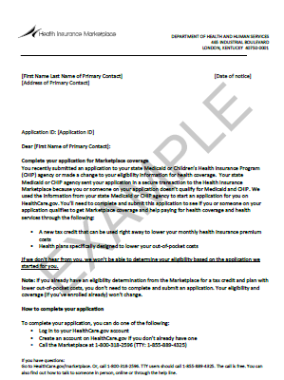
Application Transfers
Example
Inbound Account Transfer Notice
https://marketplace.cms.gov/technical-assistance-resources/training-materials/inbound-account-transfer.pdf
Double click to open
KHBE
Kentucky Health Benefit Exchange
Notes:
Double click in white area off of letter image

Slide 30
Minimum Essential Coverage Check (MEC)
Application Transfers
When an individual applies on HealthCare.gov, the federal system will check if the individual is receiving Medicaid benefits in Kentucky. benefind will process the requests and respond in one of three ways in real time:
1) Full Match: the person is known to our system and has benefits for the time period requested
2) Partial Match: the person is known to our system and has benefits for part of the time period requested
3) No Match: the person is not known to our system or is known to our system but does not have
benefits for the period requested
During the HealthCare.gov application process, and the request is sent from HealthCare.gov and benefind replies in real time.
KHBE
Kentucky Health Benefit Exchange
Notes:
Quarterly checks

Slide 31
Kynect.ky.gov
kynect.ky.gov
You can still access the 2016 kynect website
New landing page for kynect.ky.gov starting 11/1/16
KHBE
Kentucky Health Benefit Exchange
Notes:
There is not necessarily a wrong place to start but let’s discuss the timeline and function of the different sites and how you will use them

Slide 32



Facilitating an Enrollment
Notes:
This is the layout for kynect.ky.gov after November 1. Consumers can find in person assistance, manage their 2016 coverage, prescreen for eligibility, and transfer to either benefind or healthcare.gov to apply for and enroll in 2017 coverage. Explain each button, search/map, each year button (pre-screening) Stress importance of prescreening for 2017. Will save consumer time in getting coverage

Slide 33


When users click the 2017 button they will be taken to the pre-screening page.
Direct link to HealthCare.gov
Direct link to benefind
Click Next to continue pre-screening
Notes:
When consumers use the 2016 button from the landing page, they will navigate to this Quick Pre-screening page. Here consumers can link directly to HealthCare.gov (top blue banner) or go directly to benefind (blue button lower right). They can continue the prescreening process by clicking the Next button.

Slide 34
benefind.ky.gov
benefind.ky.gov
benefind is Kentucky’s portal to apply for assistance and support programs.
Medicaid/KCHIP eligible individuals.
For individuals close to both Medicaid and QHP eligibility, enroll early in open enrollment on benefind.ky.gov to help avoid coverage gap.
If someone applies through benefind but qualifies for a QHP, their application will transfer to FFM.
Agents may get calls from consumers who applied on benefind but were notified they are QHP eligible
KHBE
Kentucky Health Benefit Exchange
Notes:
Expanded abilities will include entering information into the SNAP application. There are limitations to this added function and DCBS will provide training.

Slide 35
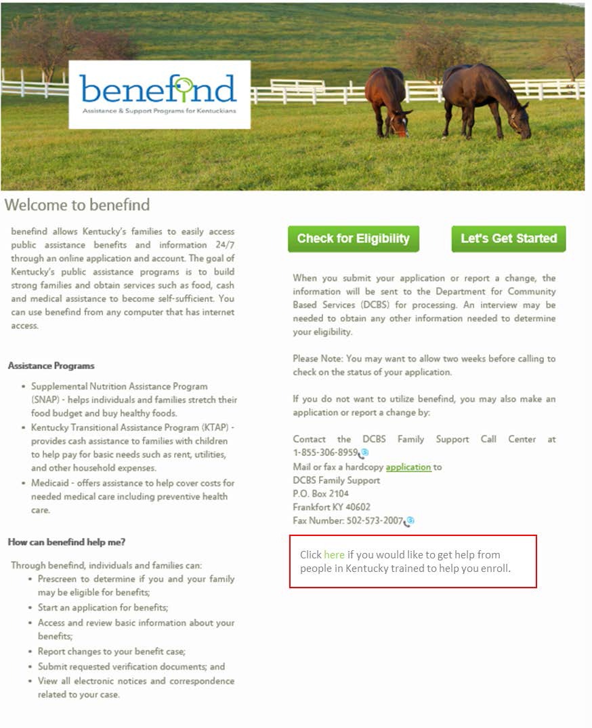
Notes:
Benefind In red box, also leads to map seen previously

Slide 36
HealthCare.gov
HealthCare.gov
All QHP applications will need to be entered and submitted through HealthCare.gov. No previous year information will transfer to HealthCare.gov.
If an individual applies on HealthCare.gov but potentially qualifies for Medicaid, their application information will transfer to benefind. DCBS may need further information and interview to complete enrollment.
KHBE
Kentucky Health Benefit Exchange
Notes:
We talked about transfer of information earlier but please stress that no PREVIOUS year information will transfer.
Users will find the application is very similar to what you are used to. kynect application modeled after the HealthCare.gov application.

Slide 37
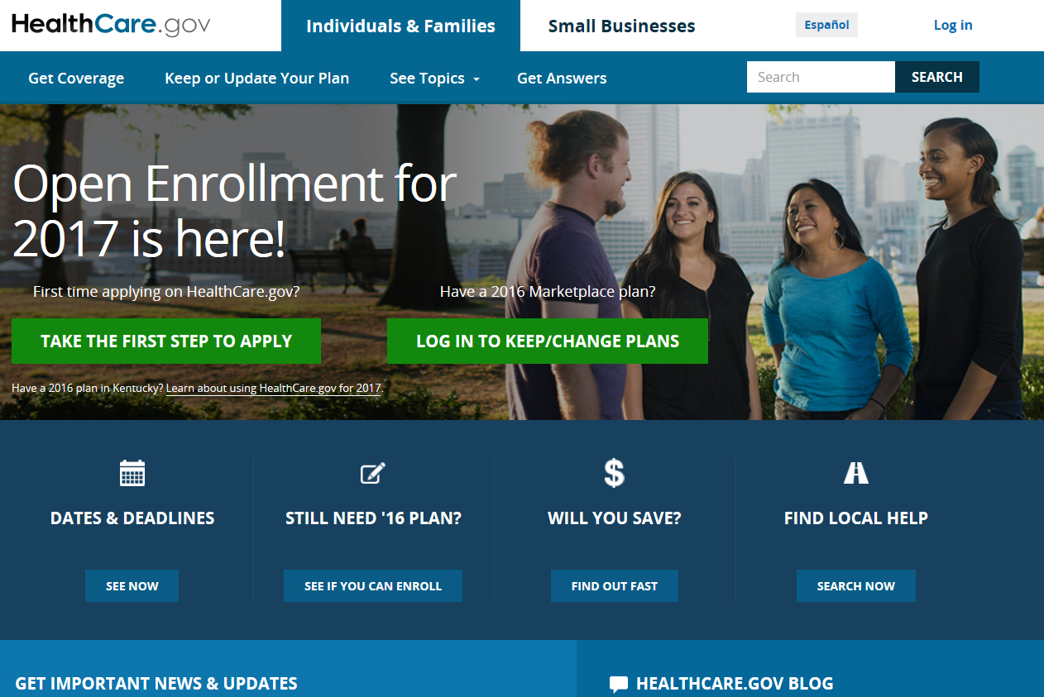
Facilitating an Enrollment
Notes:
Healthcare.gov. This screen will change depending on season.

Slide 38
Facilitating an Enrollment
YOU DO NOT NEED TO GO TO EACH WEBSITE
kynect.ky.gov
Prescreening, finding local assister, 2016 information, portal to other sites
benefind.ky.gov
Medicaid eligible individuals
kynect dashboard still available for benefind clients.
HealthCare.gov
All QHP applications will need to be entered and submitted through healthcare.gov. No previous year information will transfer to healthcare.gov.
If an individual applies on healthcare.gov but potentially qualifies for Medicaid, their application information will transfer to benefind.
KHBE
Kentucky Health Benefit Exchange
Notes:
Recap each site.

Slide 39
Facilitating an Enrollment
Special Circumstances may require you to go to both HealthCare.gov and benefind.ky.gov
For mixed eligibility households (example: parent QHP and children KCHIP):
Currently our best recommendation is to enroll the parents as early in open enrollment as possible on HealthCare.gov. The kids stay on benefind until their recertification date.
For individuals with new enrollments on the cusp of QHP eligibility:
Enroll these consumers as early as possible. If they are potentially eligible for Medicaid, the FFM will transfer their file to the state for Medicaid assessment.
KHBE
Kentucky Health Benefit Exchange

Slide 40
Facilitating an Enrollment
Enrollment Steps
There will be no passive QHP enrollments for plan year 2017 or transfer of client information to Federal database.
Application on HealthCare.gov is very similar to the application questions you are already using.
There is a screen in the HealthCare.gov application to enter your name and NPN when assisting a client. This is not the same as being associated with a case in kynect.
KHBE
Kentucky Health Benefit Exchange
Notes:
No passive enrollment is a huge point. Stress how important kynectors will be in helping in this process
Stress that we will share best steps for Mixed Households, Medicaid only, QHP only. We want to minimize gaps in coverage the best we can. We are expecting more information soon to be able to give you direction in the application process of how to best handle different cases to manage this the best way available
Stress that they will be familiar with most of the process

Slide 41
Training
and Resources

Slide 42
2017 FFM Registration for Agents
Annual FFM Registration Requirements
Register
Complete registration on the CMS Enterprise Portal at https://portal.cms.gov
Agents and brokers who have previously participated in the FFMs already have a CMS Enterprise Portal account and must use their existing credentials to log in to the portal to access the MLMS.
SHOP Agreement
To continue participation in the SHOP Marketplace each year, must also complete an MLMS profile and execute the SHOP Marketplace Agreement, and are strongly encouraged to complete the associated training and exams.
Refresher if Returning
Agents and brokers who participated in the FFMs for the Individual Marketplace for plan year 2016 are eligible to take a streamlined Refresher Training either through the MLMS or a CMS-approved vendor regardless of how they completed the plan year 2016 training.
Web based Training or vendor
For plan year 2017, agents and brokers can complete the CMS-developed training on the MLMS or through a CMS-approved vendor. Agents and brokers will access both the CMS-developed training and CMS-approved vendor training via the CMS Enterprise Portal at https://portal.cms.gov.
KHBE
Kentucky Health Benefit Exchange

Slide 43
Training
Agent Training
Complete FFM Training
Send Certificate of Completion to KHBE.kynect@ky.gov
If Agents are interested in assisting clients with Medicaid or KCHIP (for example; a mixed eligibility household) they must complete benefind training in addition to the above requirements
benefind training is NOT required for Agents to be certified by KHBE
KHBE
Kentucky Health Benefit Exchange

Slide 44
Agents FFM Training
Seven Steps to FFM Training
1
Create a Centers for Medicare & Medicaid Services (CMS) Enterprise Portal account
Request the FFM Agent/Broker role on the CMS Enterprise Portal
Conduct identity proofing on the CMS Enterprise Portal
Complete the required training curricula and exams on the Marketplace Learning Management System (MLMS) or through a CMS-approved vendor
Complete profile information on the MLMS, which is available via the CMS Enterprise Portal
Execute the General Agreement and the Individual Marketplace Privacy and Security Agreement on the MLMS
Confirm completion of all required steps on the Agent Broker Registration Status page on the CMS Enterprise Portal
2
3
4
5
6
7
KHBE
Kentucky Health Benefit Exchange
Notes:
Similar to the same steps you had to take to become registers/certified with the state of KY

Slide 45
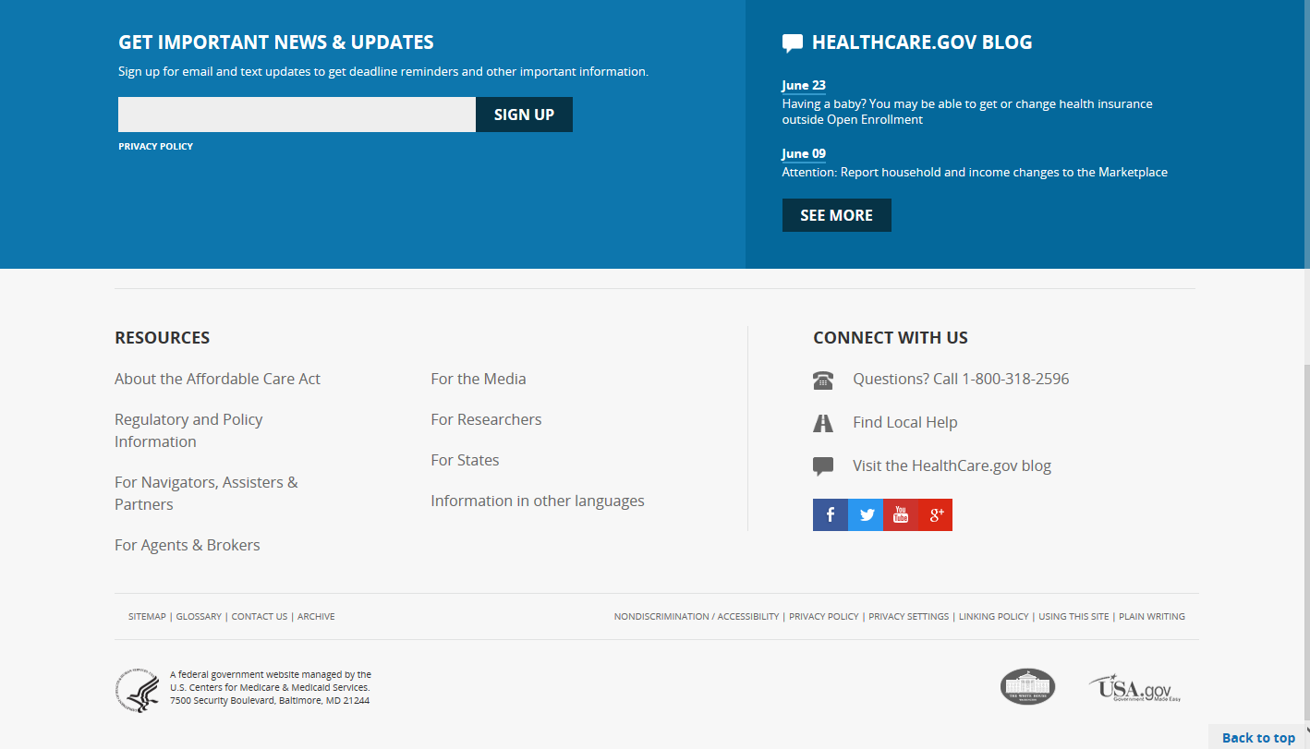
kynectors as Application Assisters
Toolkit
KHBE
Kentucky Health Benefit Exchange
Notes:
This is at the bottom of HC.gov web page

Slide 46
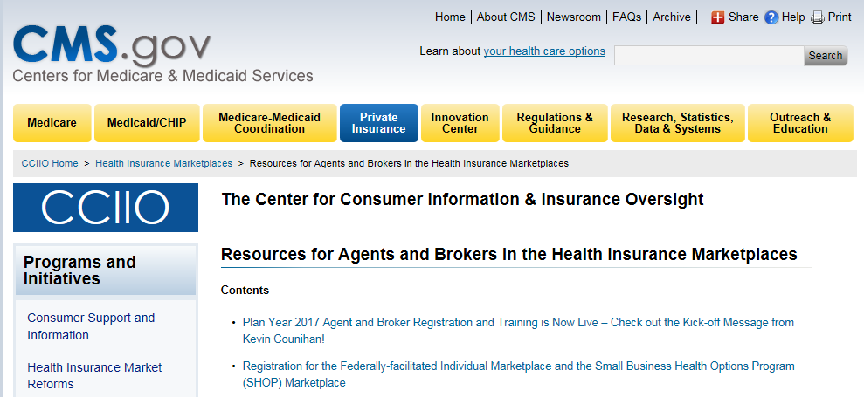
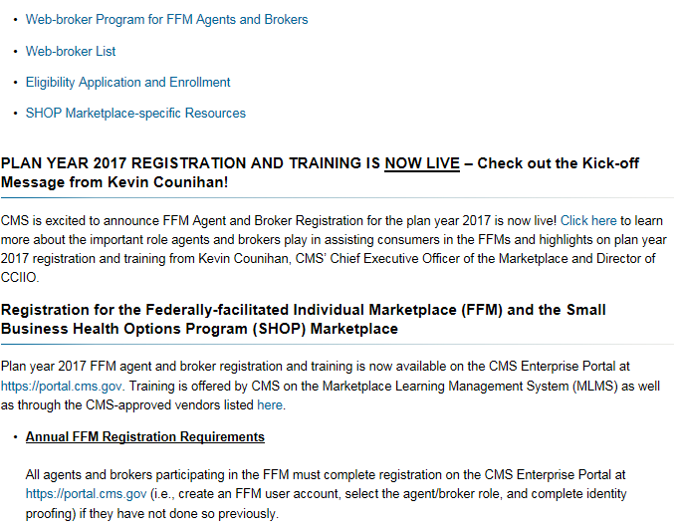
kynectors as Application Assisters
Toolkit
KHBE
Kentucky Health Benefit Exchange

Slide 47
Agents in the FFM
You must enter a correct National Producer Number (NPN) in your MLMS profile to receive credit for completing registration.
The NPN can be up to 10 digits long and must not begin with a zero (0).
The NPN must not include any special characters or letters.
The NPN is generally not the same as your state license number. You should be sure to use your NPN, not a state license number.
To update the NPN, select the “Complete Agent Broker Training” link and update the information in your MLMS profile.
Agent and broker NPNs can be found at: www.nipr.com/PacNpnSearch.htm
You should confirm your NPN is correct in your MLMS profiles. Entering an inaccurate NPN could result in denial of compensation/credit by an issuer.
KHBE
Kentucky Health Benefit Exchange
Notes:
Basically the issuer has to have verification of license and completion of FFM training before they can let agent assist consumers directly through an issuer’s site.
Any question about commission schedule or rate is between issuer and agent only. KHBE does not oversee this function.

Slide 48
Training
State Requirements for Assisters
Complete FFM Training for Assister role
Complete benefind Training
Send Certificate of Completion to KHBE.kynect@ky.gov
KHBE
Kentucky Health Benefit Exchange

Slide 49
kynectors as Application Assisters
Toolkit
KHBE
Kentucky Health Benefit Exchange
Notes:
This is at the bottom of HC.gov web page.
Tool kit available that includes media pieces, manuals, on going training, and sample notices and forms. Can look at this as having a new partner in our effort to provide a path to coverage for Kentuckians

Slide 50
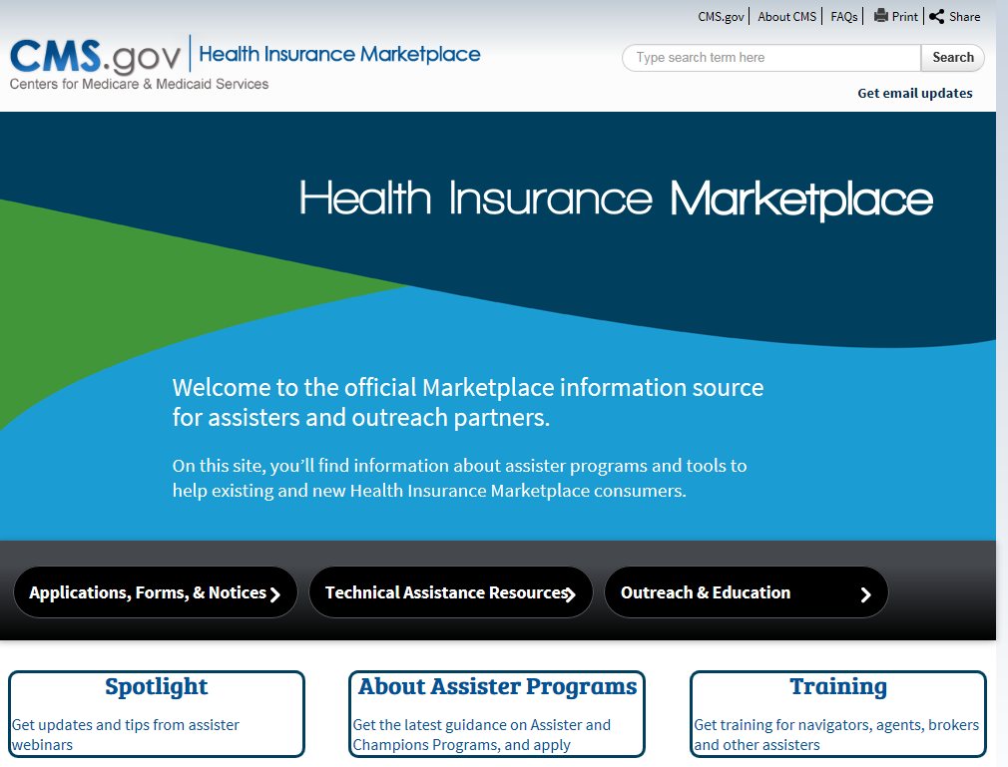
kynectors as Application Assisters
Toolkit
Notes:
Tool kit available that includes media pieces, manuals, on going training, and sample notices and forms. Can look at this as having a new partner in our effort to provide a path to coverage for Kentuckians

Slide 51
Training
Announcements
Deploy Information
Quick Reference Guides
Job Aids
Webinars by KOHBIE and FFM
Sign up for CMS email updates
KHBE
Kentucky Health Benefit Exchange
Notes:
benefind training will be facilitated by DCBS. KOHBIE will send an announcement when this training is available and how to complete
Completion certificates must be on file with KOHBIE
KOHBIE manages the search function on kynect.ky.gov. If you do not want to be searchable on the healthcare.gov website you will need to contact CMS
There are additional learning opportunities through webinars, WBTs and forums hosted by KHBE, CMS and other entities. We will post training and information on the HBE site under resources. Announcements will be sent anytime there is something added to resources.

Slide 52
Training
Resources
HBE Website
http://healthbenefitexchange.ky.gov/Pages/Agents-and-kynectors.aspx
Agents and Brokers
https://www.cms.gov/cciio/programs-and-initiatives/health-insurance-marketplaces/a-b-resources.html
CMS News
https://www.cms.gov/Newsroom/Newsroom-Center.html
KHBE
Kentucky Health Benefit Exchange
Notes:
Resources will be posted on HBE website u

Slide 53
HealthCare.gov
Processes
Notes:
We will host webinars on the upcoming topics to expand on the details and processes of each.

Slide 54
Application Process
Online
Paper
Call Center
Quick
Dynamic application that gathers all necessary information
Complete process at one time
Must create an online account
ID Proofing before moving forward
Can complete several in a single event
Can send copies of ID information with application
Delays
Must wait for FFM to enter
Questions may not be answered completely
Will involve follow up
Quick
All info is entered
Complete process at one time
Cannot see the screen when they are reviewing available plans
Wait times during OEP
KHBE
Kentucky Health Benefit Exchange
Notes:
Three ways to apply. Benefits to each method.

Slide 55
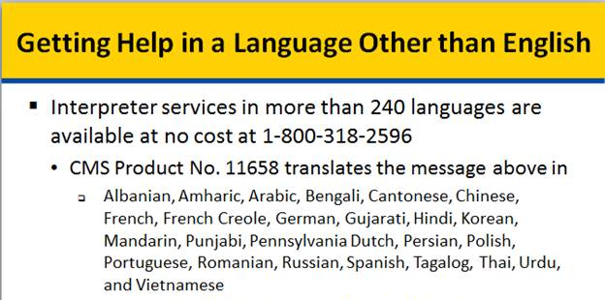
HealthCare.gov
Language Line
https://marketplace.cms.gov/outreach-and-education/getting-help-in-a-language-other-than-english.pdf
KHBE
Kentucky Health Benefit Exchange

Slide 56
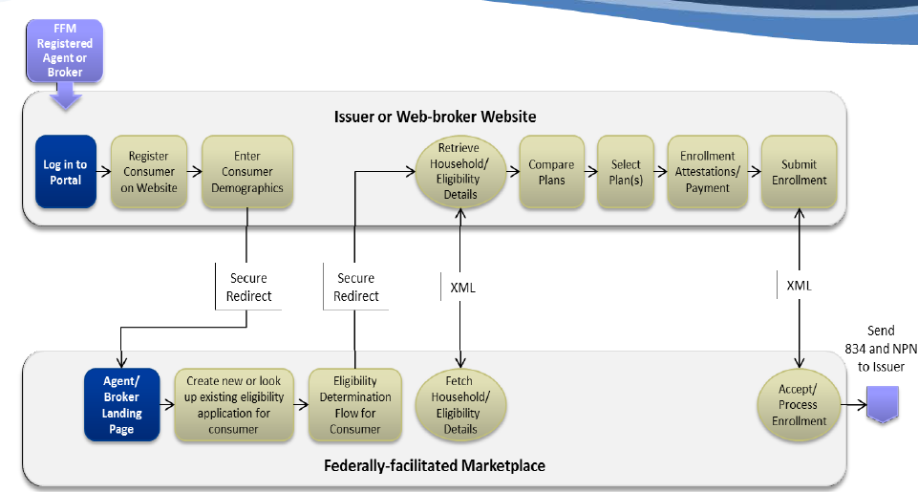
HealthCare.gov
Direct Enrollment Pathway Using an Issuer or Web-Broker Website
KHBE
Kentucky Health Benefit Exchange

Slide 57
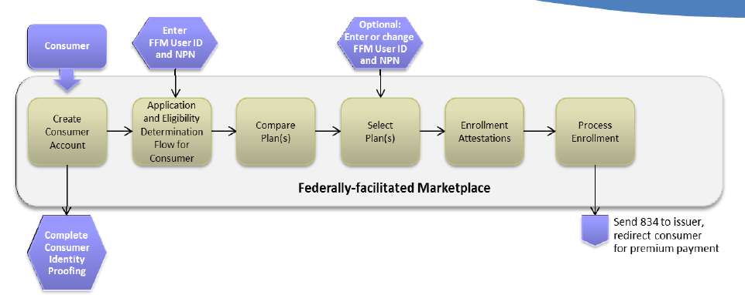
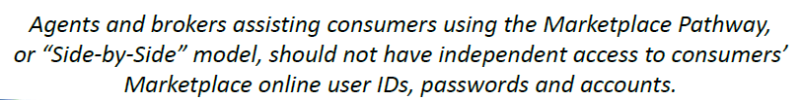
HealthCare.gov
Marketplace Pathway or “Side-by-Side”
KHBE
Kentucky Health Benefit Exchange

Slide 58
HealthCare.gov
Beginning this Open Enrollment, the Individual Marketplace Call Center is streamlining access for agents and brokers who have completed 2017 Marketplace registration.
To access this enhanced agent/broker service, follow the steps below.
Call 855-788-6275.
Enter your NPN.
Only registered agents/brokers with the Marketplace will be able to access this enhanced service.
Valid NPNs will be updated weekly (typically on Fridays).
When a valid NPN is entered, agents/brokers will be presented with three (3) options:
  Password Resets for consumer HealthCare.gov accounts
  Special Enrollment Periods (that aren’t common/available through the application)
  Other Issues
Agents/brokers entering invalid NPNs will be transferred to the main Marketplace Call Center line.
KHBE
Kentucky Health Benefit Exchange

Slide 59
HealthCare.gov Account Creation
Account Creation
Must create an account to:
Access application online
Select plan online
Online enrollment
Manage account
Email address
Will need email address to create account.
Have access to that email account
Use same email used on application
KHBE
Kentucky Health Benefit Exchange
Notes:
Creating an account is one of the first steps for consumers to apply online or access their application/enrollment information online.
Will need to have an email account. Use caution to use an email address they have access to.

Slide 60
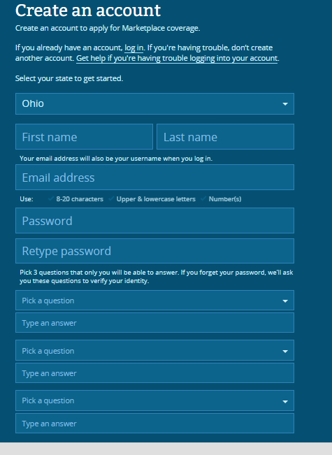
Creating a HealthCare.gov Account
Don’t create more than one account
Helpful to write down and keep in safe place
Notes:
Creating an account is not required to apply and enroll. Consumers can apply via the call center or with a paper application without creating an account. The only way to access the application and enrollment online is by creating an account. Account can be created at a later time (i.e. after application has been completed through the call center or by mailing in paper application.) It is very important to use an email account that consumers have access to and remember. May need to assist with email creation.

Slide 61
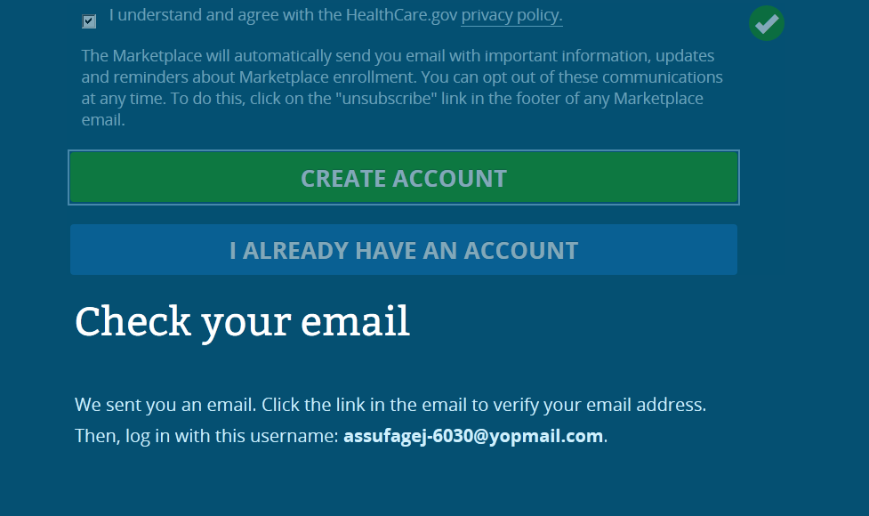
Creating a HealthCare.gov Account
Notes:
Creating an email; gmail, yahoo,
Will need to verify email before they can log in

Slide 62
ID Proofing
ID Proofing
Must prove identity when system doesn’t recognize
Can resolve
through call with Experian
upload documents
mail documents
KHBE
Kentucky Health Benefit Exchange

Slide 63
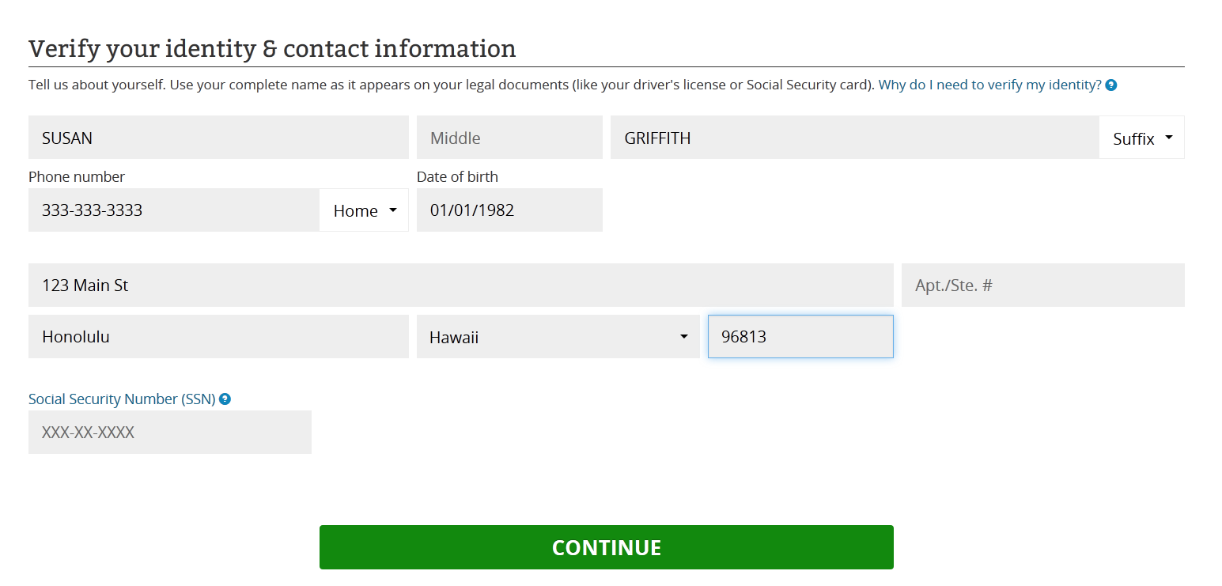
ID Proofing
KHBE
Kentucky Health Benefit Exchange

Slide 64
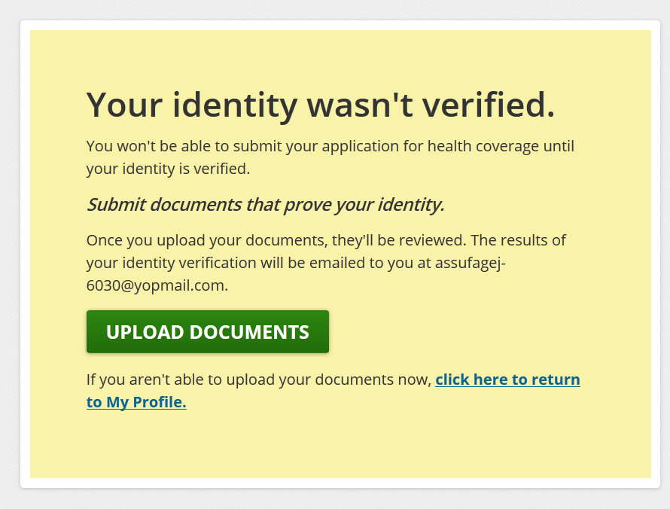
ID Proofing
KHBE
Kentucky Health Benefit Exchange
Notes:
Read the entire screen

Slide 65
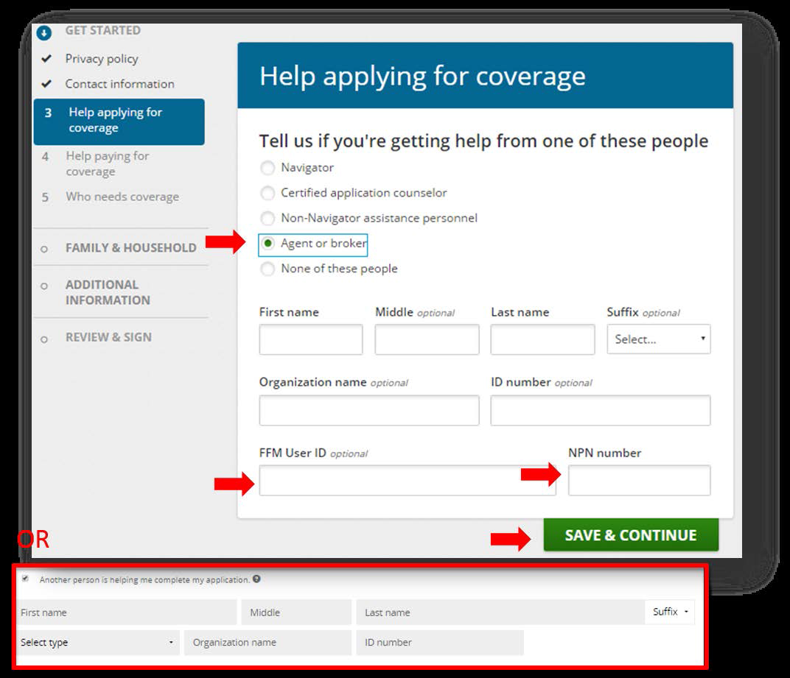
Adding NPN Number
KHBE
Kentucky Health Benefit Exchange
Notes:
Also another location to enter during plan selection

Slide 66
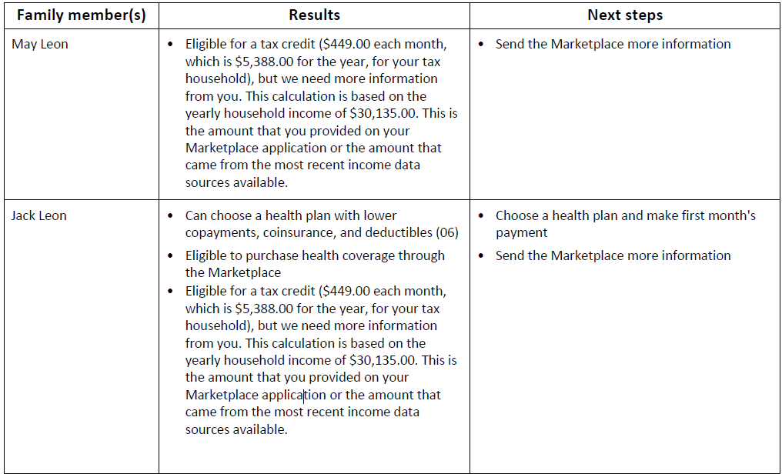
Eligibility Results
Eligibility Results
At the end of the application, Eligibility results are generated immediately.
If paper application was submitted, a Notice of Eligibility will be mailed to consumer
KHBE
Kentucky Health Benefit Exchange
Notes:
Tax credit and CSR. Much more information in notice such as what additional information is needed, where to send it, what to send and what to do if you disagree with the eligibility results

Slide 67
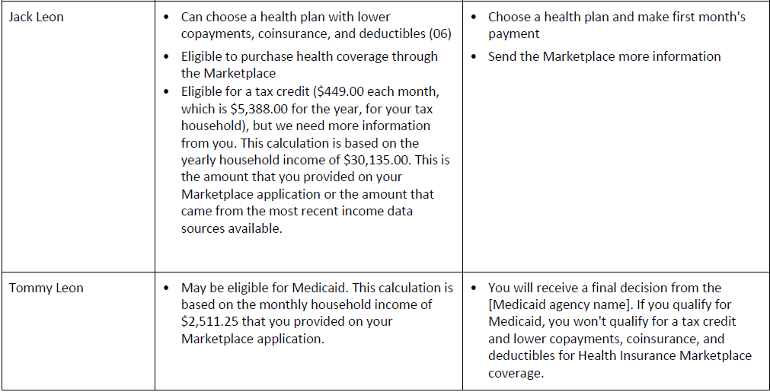
Mixed Eligibility
Mixed Eligibility
Eligibility Notice will indicate what program each person on the application is qualified for and indicate any next steps
KHBE
Kentucky Health Benefit Exchange
Notes:
APTC And CSR for Jack. Instruction to send more information (there is detail about what to send later in the letter)
Note the wording MAY be eligible and instruction that consumer will receive a final decision from the state Medicaid agency.

Slide 68
Data Matching Issues
Also called DMI or Inconsistency. Was called RFI in KY system
Raised income level threshold from 10% to 25% to alleviate inconsistencies for 2017
Can continue with enrollment
Resolve by uploading requested documents or mailing documents
KHBE
Kentucky Health Benefit Exchange
Notes:
DMI is a result of information not matching records from trusted data sources. Will do webinar on this. Typically for citizenship or income

Slide 69
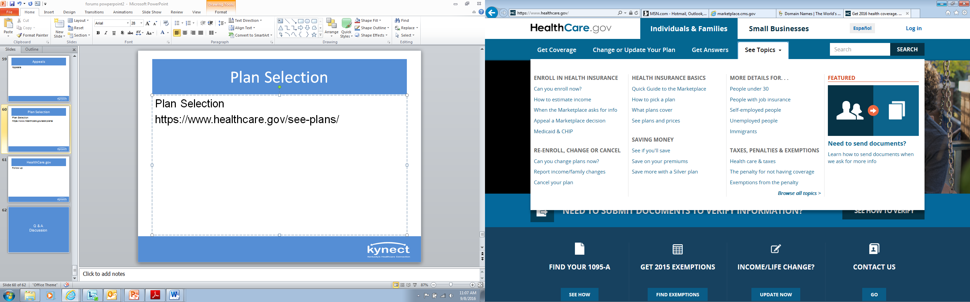
Plan Selection
Plan Selection
https://www.healthcare.gov/see-plans/
KHBE
Kentucky Health Benefit Exchange
Notes:
Plan comparison and selection on healthcare.gov is similar to what you are accustomed to, with filters and links to plan information. You can practice with the plan compare tool at hc.gov. (see above steps to access) use a zip code from a FFM state like OH or IN (46236)

Slide 70
HealthCare.gov
Primer for Agents and Brokers
https://www.regtap.info/uploads/library/AB_slides_102616_5CR_102616.pdf
HealthCare.gov Agent assistance line: 1-855-788-6275
Call 1-855-788-6275.
Enter your NPN. Only registered agents/brokers with the Marketplace will be able to access this enhanced service.
Valid NPNs will be updated weekly (typically on Fridays).
When a valid NPN is entered, agents/brokers will be presented with three (3) options:
  “Password Resets” for consumer HealthCare.gov accounts
  “Special Enrollment Periods” (that aren’t common/available through the application)
  “Other Issues”
Agents/brokers entering invalid NPNs will be transferred to the main Marketplace Call Center line.
KHBE
Kentucky Health Benefit Exchange
Notes:
AHRC provides policy guidance only, not casework
HICS is system for resolving specific case issues

Slide 71
Thank You
Notes:
What confuses you most? What do you feel most comfortable with?

