Slide 1


Telehealth/
Telemedicine
Lisa English Hinkle

Slide 2
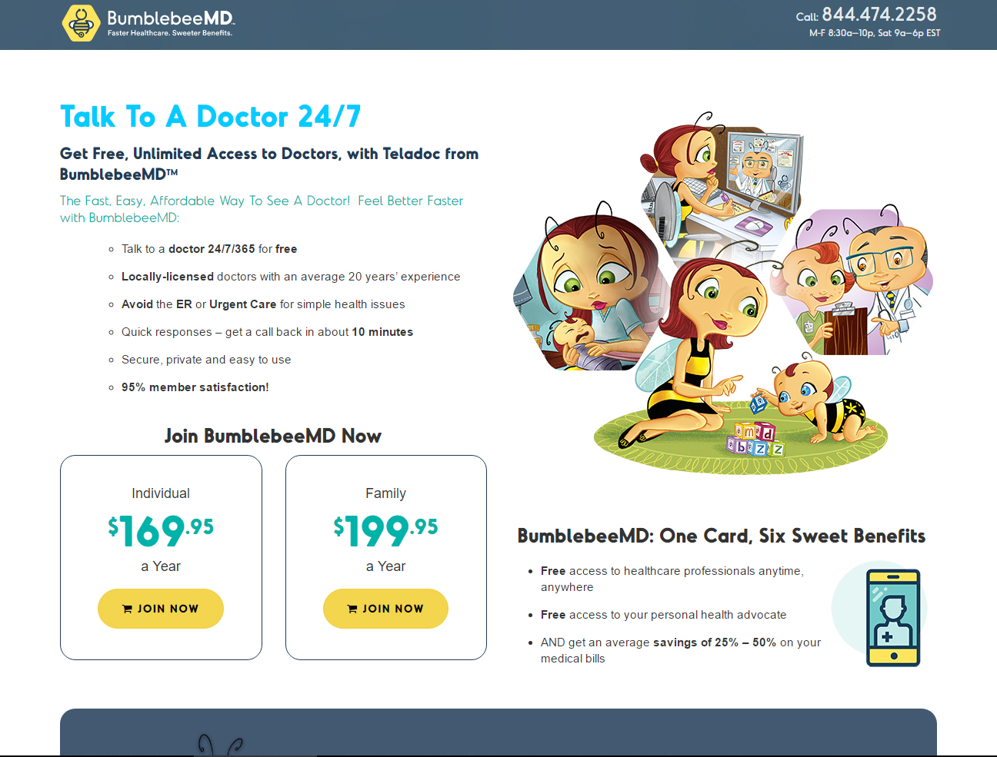

Slide 3


Slide 4


Slide 5


Slide 6
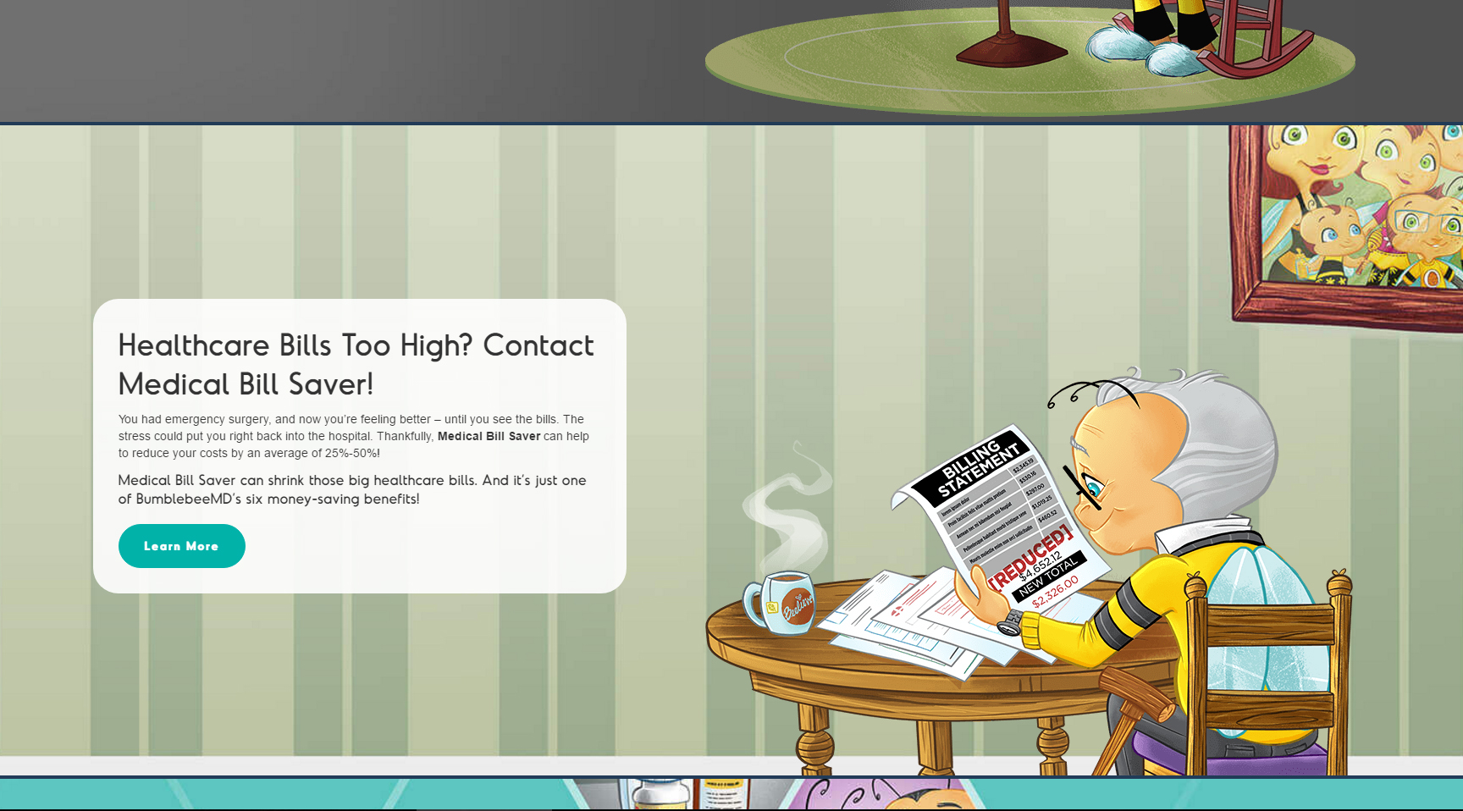

Slide 7


Slide 8
Why telemedicine?
The Affordable Care Act has resulted in millions of newly eligible insurable Americans seeking access to an already strained health care system.
There is a serious shortage of primary care providers nationwide, especially in rural areas.
Video encounters, mobile health, and remote monitoring, among other tools, can extend the reach of health services, result in greater patient adherence to care plans, increase proactive engagement, reduce hospital readmissions, and improve patient satisfaction.

Slide 9
Why telemedicine?
On December 15, 2016, the Federation of State Medical Boards (“FSMB”) released the results of a 2016 survey of state medical boards.
The survey found that the single most important regulatory topic for state medical boards in 2016 was telemedicine.

Slide 10


Why telemedicine?
Even though 20% of the American population lives in rural areas, only 11% of all physicians practice there.
Source: Meeting the Primary Care Needs of Rural America: Examining the Role of Non-Physician Providers, National Conference of State Legislatures, http://www.ncsl.org/research/health/meeting-the-primary-care-needs-of-rural-america.aspx.

Slide 11
Telehealth/Telemedicine:
The Basics
The Center for Medicare and Medicaid Services (“CMS”) defines “telemedicine” as the “provision of clinical services to patients by practitioners from a distance via electronic communications.”
The FSMB adopted a model telemedicine policy and defined “telemedicine” as “the practice of medicine using electronic communications, information technology or other means between a licensee in one location, and a patient in another location with or without an intervening healthcare provider.”
The American Telemedicine Association (“ATA”), a nonprofit organization dedicated to integrating telemedicine into health care systems, defines “telemedicine” as “the use of medical information exchanged from one site to another via electronic communications to improve a patient’s clinical health status.”
The American Medical Association (“AMA”) does not define the topic, but addresses telemedicine within three broad categories: store-and-forward* telemedicine, remote monitoring telemedicine, and real-time telemedicine services.

Slide 12

Telehealth/Telemedicine:
AMA Guiding Principles
Telemedicine services should be based on a valid patient-physician relationship established prior to the use of telemedicine services. This relationship can be established through methods such as a face-to-face examination, or a consultation with another physician who has an ongoing physician-patient relationship.
Patients seeking care via telemedicine must be offered a choice of provider and should have access to documentation of the licensure and board certifications of their health care practitioners in advance of their visits.

Slide 13
Telehealth/Telemedicine:
AMA Guiding Principles (cont’d)
The patient’s medical history must be collected as part of the provision of any telemedicine service, the services provided must be properly documented, and a visit summary must be provided to the patient.
Providers must establish protocols for emergency referrals.
Delivery of telemedicine services must abide by laws addressing the privacy and security of patients’ medical information.

Slide 14
What ISN’T Telehealth?
According to CMS, telehealth does NOT include phone calls, emails, images transmitted via fax, and text messages without the visualization of the patient.
  However, CMS WILL pay monthly fees to physicians, nurse practitioners, physician assistants and others to manage the care of patients with two or more chronic conditions WITHOUT face to face communication (including visualization of the patient). These covered services include communication through phone calls, secure messaging and email.
    This doesn’t mean that CMS considers these services to be telehealth.

Slide 15

What ISN’T Telehealth?
The ATA has interpreted telemedicine to include transmission of an evaluative or therapeutic act through any means, method, device, or instrumentality, including emails and phone calls.
The FSMB Model Policy tracks the CMS definition, excluding phone calls, emails, instant messaging and fax.

Slide 16
What ISN’T Telehealth?
Store and Forward?*
Store and Forward refers to technology where information is stored and transmitted to be viewed by the distant site at any time.
It is not interactive, however, and therefore does NOT meet Kentucky (or many other) standards for telehealth services.
Store and forward technology is as simple as sending x-rays or digital photos of skin conditions. In ophthalmology, retinal cameras can take pictures of retinas and send them to specialists to review for diabetic retinopathy.

Slide 17
What is the difference between “telehealth” and “telemedicine”?
The terms are often used synonymously, but precise definitions may differ, depending on which entity is defining the term. Generally, telehealth is a broader category than telemedicine, but different entities use it in different ways.
In Kentucky, “telehealth” is the term used by statute, so the remainder of this presentation will use that term.

Slide 18
HIPAA Privacy and Security
Telehealth providers must abide by the strictures of the HIPAA, which include Privacy and Security Rules.
  The Privacy Rule outlines how electronic Protected Health Information (“ePHI”) can and cannot be disclosed.
  The Security Rule requires technical and administrative safeguards to protect the retention and transmittal of ePHI to prevent breach and inadvertent disclosure.

Slide 19

Telehealth in Kentucky
Kentucky’s Medical Practice Act defines telehealth as “the use of interactive audio, video, or other electronic media to deliver health care. It includes the use of electronic media for diagnosis, consultation, treatment, transfer of medical data and medical education.” KRS 311.550(17).
In 2014, the Kentucky Board of Medical Licensure (“KBML”) adopted a helpful policy that accepts the FSMB’s model policy as the accepted and prevailing standard of practice for use of telehealth tools when practicing medicine.

Slide 20
Telehealth in Kentucky
The KBML recognizes that a patient/physician relationship via telehealth can be established with the informed consent of the patient, but includes complicated requirements for:
  Establishing the patient/physician relationship
  Obtaining informed consent
  Providing examination and treatment services
  Keeping medical records
  Maintaining patient privacy
  Prescribing

Slide 21
Telehealth in Kentucky
All requirements for prescribing whether in person or via telemedicine must be met.
Physicians will be held to the same standards for in-person prescribing when prescribing via telemedicine.

Slide 22
Getting Reimbursed for Telehealth Services - MEDICARE
CMS announced final requirements for Medicare telehealth services in 2014.
  What are the requirements?
    Beneficiary must be located in an area outside a metropolitan statistical area or in a Rural Health Professional Shortage Area (“HPSA”).
    Medicare will only pay for face-to-face, interactive consultation service.
    The patient must be present in an approved healthcare facility (hospitals, rural health clinics, physician offices, etc.)
    An interactive audio and video telecommunications system that permits real-time communication between the provider and the beneficiary must be used.

Slide 23

Getting Reimbursed for Telehealth Services - MEDICARE
Who may receive payment?
  Physicians
  Physician assistants
  Nurse practitioners
  Nurse-midwives
  Clinical nurse specialists
  Clinical psychologists
  Clinical social workers
  Dieticians or nutrition professionals

Slide 24

Getting Reimbursed for Telehealth Services - MEDICARE
What services are covered?
  Psychiatric and behavioral services
  Remote medical services
  Psychological testing
  Psychotherapy
  Prolonged office visits
  Annual wellness check-ups
  Non face-to-face chronic care management
  Transitional care management services
  Smoking cessation
  Telehealth pharmacologic management
  And more…

Slide 25
Reimbursement and Payment Issues for Telehealth
Third party payers have not traditionally covered telehealth services in the same manner as other services, and not to the same degree as the federal government.
  Telehealth services have been denied for coverage on the basis of being considered experimental or investigational.
  Third party payers have been concerned that telehealth services will lead to overutilization.
  Increased coverage costs are a concern as well, as increased access may lead to expanded coverage.

Slide 26
Telehealth Reimbursement in Kentucky
KRS 304.17A-138 (1)(a):
“A health benefit plan shall not exclude a service from coverage solely because the service is provided through telehealth and not provided through a face-to-face consultation if the consultation is provided through the telehealth network established under KRS 194A.125. A health benefit plan may provide coverage for a consultation at a site not within the telehealth network at the discretion of the insurer.”

Slide 27
Telehealth Reimbursement in Kentucky
KRS 194A.125 created a Telehealth Board to create a network of telehealth providers supported by the hospitals at the University of Kentucky and the University of Louisville.
The network includes no more than 25 rural sites established by the board, as well as ten local health departments, and any other site that is operating as a telemedicine or telehealth site that demonstrates its capability to follow the board’s protocols and standards.
There are currently 55 telehealth sites listed on kytelehealth.net, the site set up by the Kentucky Telehealth Board to handle scheduling.

Slide 28
Telehealth Reimbursement in Kentucky: Parity
KRS 304.17A-138 (2):
“Benefits for a service provided through telehealth required by this section may be made subject to a deductible, copayment, or coinsurance requirement. A deductible, copayment, or coinsurance applicable to a particular service provided through telehealth shall not exceed the deductible, copayment, or coinsurance required by the health benefit plan for the same service provided through a face-to-face consultation.”

Slide 29
Telehealth Reimbursement in Kentucky: Parity
What does this mean?
If an insured receives telehealth specifically through the telehealth network established by Kentucky statute, then that care MUST be covered.
According to the language of KRS 304.17A-138 (2), it appears as though the patient cannot be charged a deductible, copayment or coinsurance required by the health plan at a higher rate than if the service had occurred face-to-face.
In other words, insurers may elect to NOT cover telehealth at sites not included in the Kentucky Telehealth Network, but if they do, the cost to the patient cannot exceed that of similar face-to-face coverage.

Slide 30
Accountable Care and Risk-Based Reimbursement
The Patient Protection and Affordable Care Act (“ACA”) created an option for health care networks to form Accountable Care Organizations (“ACO”).
These ACOs are incentivized to provide high-quality care in an efficient manner.
Telehealth is a cost-effective way for these organizations to meet quality benchmarks in areas such as chronic care management and hospital re-admission rates (if, for instance, doctors conduct follow-up check-ups with patients via telehealth).
Telehealth should be a key tactic for health systems under risk-based reimbursement and a valuable tool.

Slide 31


Slide 32


Slide 33
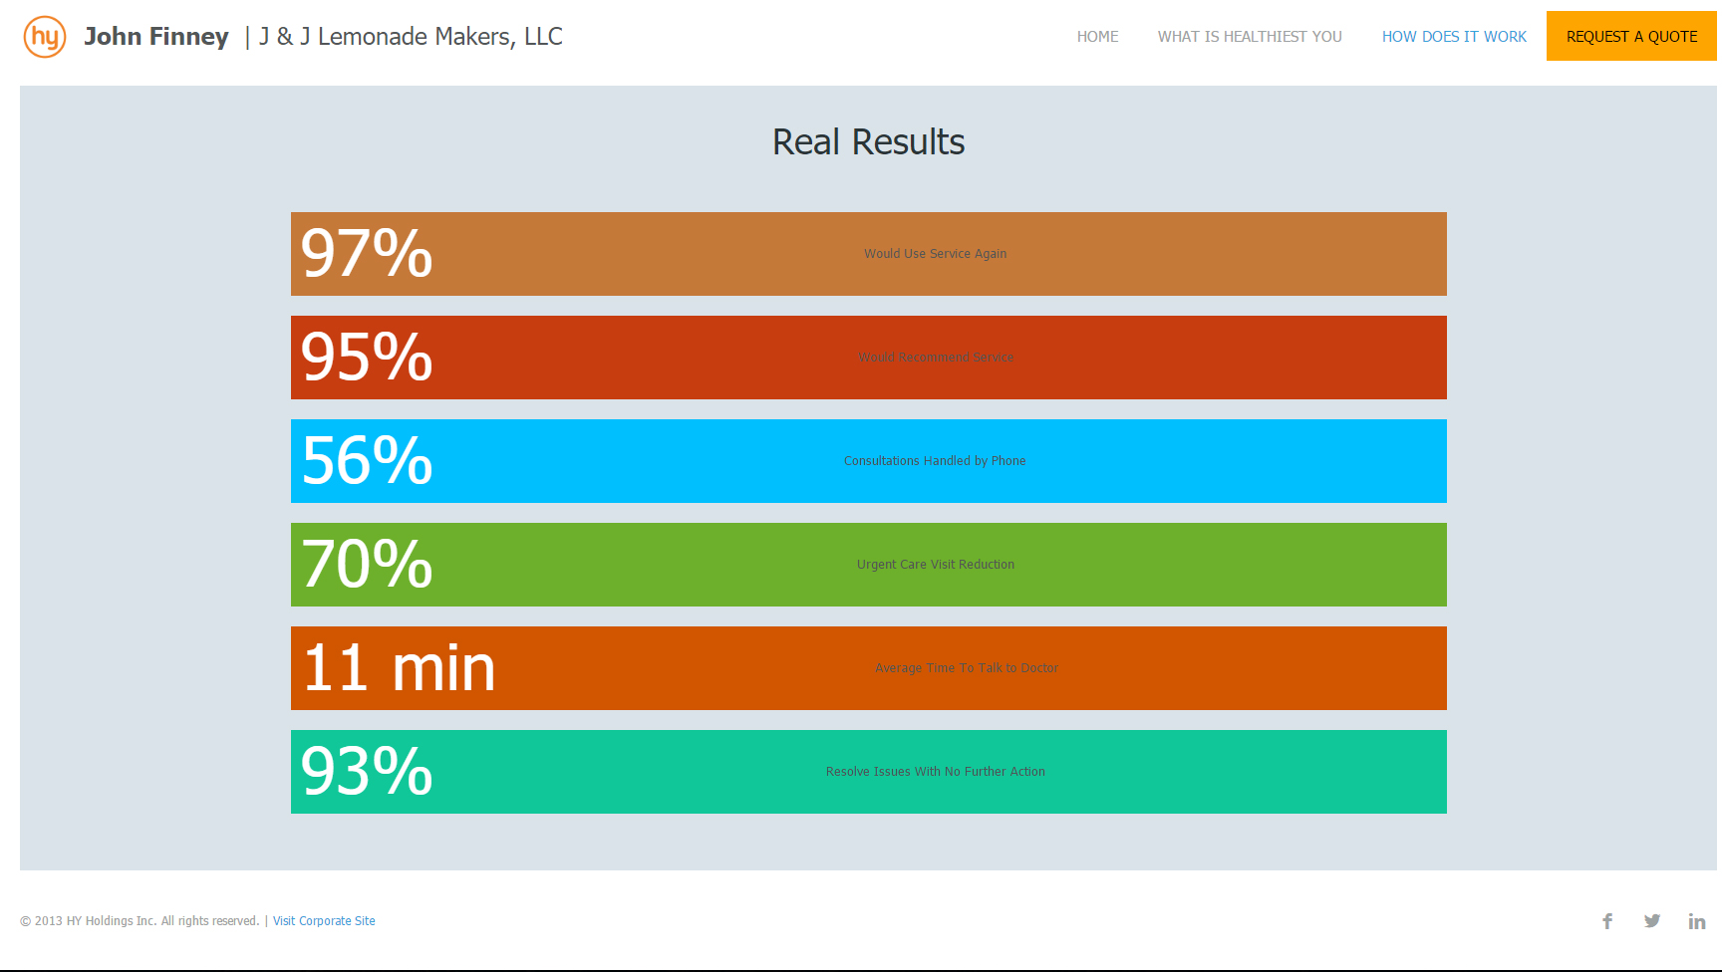

Slide 34
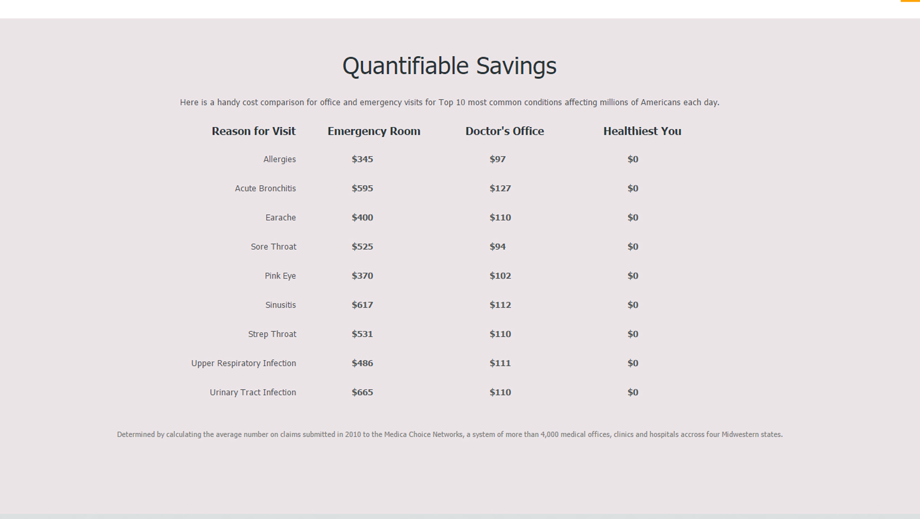

Slide 35
Contact
John Finney, MBA
(606) 424-5654
Johnfinney@bene-fits.com

Slide 36

Any questions?
Lisa English Hinkle
lhinkle@mmlk.com
(859) 231-8780, ext. 256
www.mmlk.com
www.mcbrayerhealthcare.com

