Slide 1
Is Technology Derailing Your Performance?
How to Lose the Distractions & Increase your Productivity
Jennifer Wheatley, SHRM, SHRM-SCP & Amy Olds, PHR, SHRM-CP
HR Affiliates, LLC.

Slide 2
Goals and Objectives
How “Busy” are We as a Workforce?
What are the Biggest Distractions in the Workforce?
Tips and Tools to Discourage Distractions and Increase Productivity

Slide 3
How Did We Get Here?
Nearly half (47%) of employees feel they spend thirty minutes or less per week being unproductive because of unnecessary distractions.
56% of employees say they try to make up for time spent on personal, non-work related activities while at work by working at home or in the office after standard work hours.
An estimated 28% of our workday is consumed by interruptions fueled by technology.
2.75% of American workers don’t believe they have access to the latest productivity boosting technology.
65% of employees reported they use the internet at work for non-work purposes.
The U.S. has been experiencing a slowdown in measured labor productivity since 2004 despite the introduction and growth of new technology into the workplace.
Lost productivity costs the U.S. economy approximately $588 BILLION dollars each year.

Slide 4
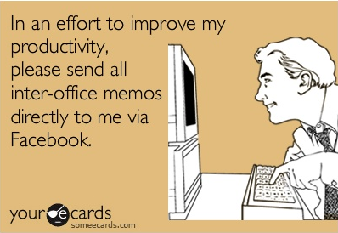
Productivity Killers

Slide 5
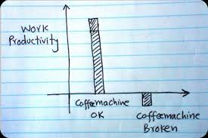
Productivity Enhancers

Slide 6

Outside Influences (Non-Technical)

Slide 7

Co-Workers

Slide 8
Co-Workers
71% of people report frequent interruptions when they are working.
Face-to-face interruptions account for one-third more intrusions than email or phone calls.
Open floor plans and low cubicles encourage collaboration but discourage high productivity.

Slide 9
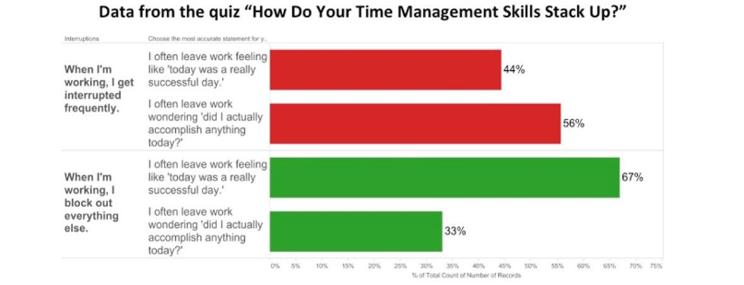
Co-Workers

Slide 10
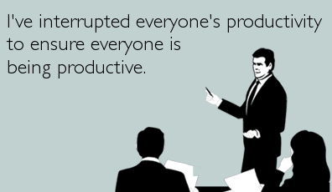
Meetings

Slide 11
Meetings
37% percent of employee time is spent in meetings.
Management can attend more than 60 meetings a month.
47% of employees consider meetings a waste of time.
39% of meeting participants admitted to dozing off during a meeting.
Over 70% of employees admit to bringing other work to meetings.
The more meetings attended, the more exhausted employees felt along with a perception of a higher workload.

Slide 12
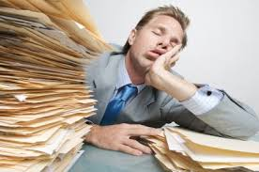
Motivation

Slide 13
Motivation
Employees don’t feel appreciated for their work.
48% of employees don’t like their jobs.
80% of U.S. workers feel stressed at the office.
$300 Billion is the cost of an unmotivated workforce.
Companies with motivated (engaged) employees were 43% more productive compared to the others.

Slide 14
Technology
Email
Instant Messaging
Internal Software
Cell Phones
Social Media

Slide 15
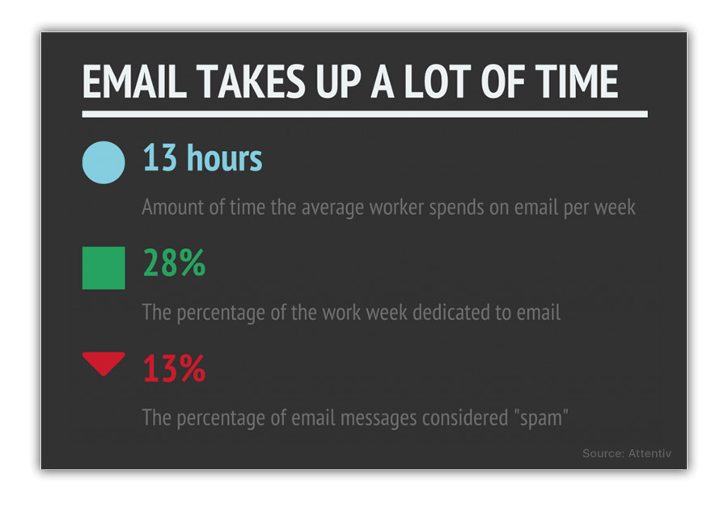
Email = The Enemy?

Slide 16
Email = The Enemy?
The average employee checks his or her email 36 times an hour.
Email is listed as the #1 killer of productivity.
Businesses lose $650 billion dollars a year due to “unnecessary” emails.
Employees use email as an instant gratification vessel.

Slide 17
Social Media
32% of the total time spent on social media during working hours is for personal use.
13% of total employee productivity is lost to social media.
A social media interruption occurs on average every 10.5 minutes.
It takes employees approximately 23 minutes to get back on track.
Each social media user costs their company $4,452 per year.

Slide 18

Two Full Work Days
That’s the amount of time we devote to Facebook on a monthly basis.
If every user replaced 20 minutes of FB time with minimum wage work, they could collectively buy the company TWO TIMES every year.
Is it really a “break”?
Engineered to be addictive.

Slide 19
Instant Messaging
Real time communication.
75% of companies use Instant Messaging at work.
Employees spend more time chatting with co-workers interfere with normal daily routines.
It can be a source of constant distraction for employees.
Enhances cognitive distraction.

Slide 20
Cognitive Distractions
The Dangers of Multi-tasking.
The Default Mode Network.
The Direct Attention Network.
It can take 10-18 minutes to get the same level of attention back.

Slide 21
The Cost of Being “Always Available”
Studies show that distractions on average cost companies $10,000 per employee annually.
Remember it can take up to 23 minutes to get back to focused work once you have been interrupted.
More likely to make mistakes.

Slide 22

Solutions???

Slide 23
Emails
Schedule time to check your email.
Choose low-productivity times.
Turn emails into action items.
Use the Trash!
Turn it Off.

Slide 24
Daily Focus Blocks
Set aside specific creative focus time – schedule a meeting with yourself.
Start small and build up your time.
Don’t give in!
Tackle a clearly identified and isolated task.
Consider using a different location.
When possible, use pen and paper.

Slide 25
War Against Interruptions
Time Lock Agreements
Identify your Time Bandits
Everyone is given dedicated quiet time to concentrate
Agree in writing not to interrupt
Studies show that productivity increased by 40-60%

Slide 26

Flow Lights

Slide 27
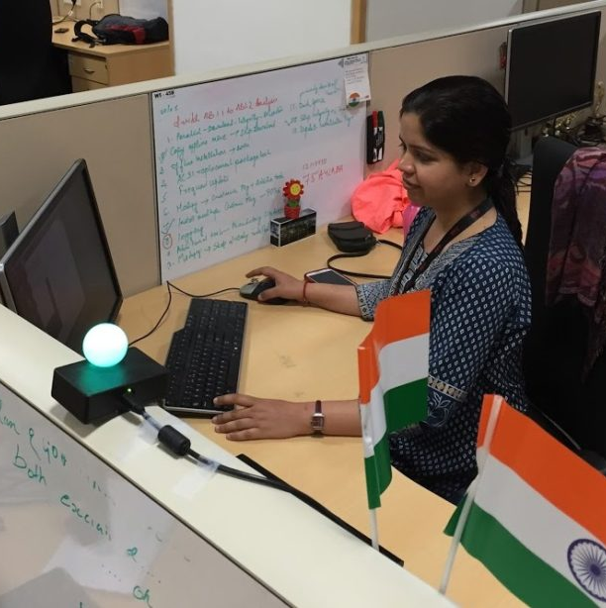
Red or Green?
FlowLights have reduced office interruptions by 46%
Lights motivated them to work faster
Red light can be lit no more than a maximum period per day

Slide 28
Do You Have the Right Technology?
Manage Passwords – iPassword, Chrome extensions (LastPass)
Evernote
Headspace
Calendars
Boomerang (Emails)

Slide 29
Is it Working?
Measure Tasks, Not Hours or Days
Manage Communications and Expectations
Set Goals
Let the Results Tell the Story

Slide 30

What Have we Learned??

Slide 31

Questions

