Slide 1

Presented by:
Lauren Johnson & Deanna Sizemore
NABIP Central Kentucky Chapter
January 17, 2023
Lauren Johnson
President/Owner
2024 Compliance Targets for
Health & Welfare Plans

Slide 2
Why is Compliance Important?
DOL has broad authority to audit compliance with ERISA
Audits performed by the Employee Benefit Security Administration (EBSA)
Focus is on ERISA compliance:
Fiduciary obligations
Reporting and disclosure
Group health plan requirements
Compliance with the Affordable Care Act (ACA)
Compliance with the Consolidated Appropriations Act (CAA) of 2021
In 2022, EBSA saw a significant decrease in enforcement actions for the second consecutive year.
EBSA’s recent pause in enforcement (EBSA Notice 2020-01) expires 60 days after the announcement of the end of the COVID-19 National Emergency (5/11/2023).
DOL’s enforcement activity is expected to return to more typical levels due to the expiration of the NE.
Increase in requirements under the Consolidated Appropriations Act (CAA)

Slide 3
Why is Compliance Important?
Audits are stressful and time consuming
Disruption of day-to-day operations
ERISA violations can be costly
Penalties
Corrective action
Civil litigation and criminal prosecution
Enforcement Actions
$931 million
Voluntary Correction Program
$8 million
Abandoned Plan Program
$84 million
Informal Complaints
$422 million
Recovered in 2022

Slide 4
ERISA Requirements
Most group health plans sponsored by private sector employers ARE subject to ERISA.
Subject to ERISA
Corporations
Exempt from ERISA
Governments
Churches
Partnerships
Sole Proprietorships
Nonprofit organizations

Slide 5
ERISA Requirements
Plan Document
Reporting & Disclosure
Fiduciary Responsibility
ACA
COBRA
Group Health Plan Requirements

Slide 6
Plan Document
ERISA requires every employee benefit plan to be established and maintained pursuant to a written plan document
The plan document must be provided to a participant or beneficiary no later than 30 days after a written request
Common Compliance Issues
Undocumented arrangements – Flex Plans, HRAs and EAPs
Relying on “Certificate of Coverage” as the plan document for fully insured plans
Poor documentation of benefits for self-funded plans
Plan documents not properly amended for applicable law or benefit changes
Tip: Consider a wrap document to supplement insurance documents and provide missing ERISA provisions.

Slide 7
Summary Plan Description (SPD) & Summary of Material Modifications (SMM)
Purpose is to communicate plan benefits, changes, rights and obligations to plan participants and beneficiaries
Must be re-distributed every 5 years if there have been any changes, 10 years if there have been no changes
Must be provided to plan participants and beneficiaries within 90 days of the effective date of coverage
Best practice to distribute SPD with annual enrollment materials
SMM or updated SPD must be provided to plan participants and beneficiaries no later than 210 days after the end of the plan year in which the change is adopted, if no material reduction in benefits or 60 days after the effective date of the change if there is a material reduction in benefits
Common Compliance Issues
Failing to distribute timely
Benefit booklets provided by health insurance carriers are not SPDs
SPD does not properly reflect eligibility requirements
Failing to distribute a SPD for each benefit plan
Does not include required provisions (WHCRA, claims procedures, ERISA rights, etc.)

Slide 8
Participant Disclosures
Notices Required to be Distributed
Medicare Creditable Coverage Women’s Health & Cancer Rights Act (WHCRA) Newborns’ & Mothers’ Health Protection Act (NMHPA) Premium Assistance under Medicaid & the Children’s Health Insurance Program (CHIPRA) HIPAA Notice of Privacy Practices HIPAA Special Enrollment Rights Notice of Grandfathered Status (if applicable) | Patient Protection Notice (if applicable) COBRA Notices Wellness Notice of Reasonable Alternative(s) ADA Wellness Notice (if applicable) Marketplace Exchange Notice COBRA compliance documents Surprise Billing Rights Notice ICHRA Notice QSEHRA Notice

Slide 9
Form 5500
Must be filed by the end of the 7th month following the end of the plan year (July 31 for calendar year plans)
2 ½ month extension is available if Form 5558 is timely filed
Required for all retirement plans
Required for “unfunded” welfare benefit plans covering more than 100 participants as of the first day of the plan year
Required for welfare benefit plan regardless of size if “funded”
Common Compliance Issues
No blanket exemption for non-profit organizations
Filing a consolidated Form 5500 without a wrap document in place
Failing to identify which benefits are subject to the filing requirement
Don’t forget health FSAs, HRAs and certain EAPs

Slide 10
Summary Annual Report (SAR)
Prescribed format
Must be provided by the end of the ninth month following the end of the plan year (September 30 for calendar year plans)
Extension of 2 ½ months available if Form 5558 is timely filed
Summary of the information submitted on the annual Form 5500
Common Compliance Issues
Common misconception SAR is not required for group health plans
If fully-insured or plan is “funded,” SAR is required

Slide 11
HIPAA
Limit plan’s uses and disclosures of protected health information (PHI)
Business Associate Agreements
Privacy and Security Policies and Procedures
Minimum necessary use and disclosure
Increased penalty provisions under HITECH
Breach/encryption protocols
Risk assessment
Annual HIPAA training for employees with access to PHI
Access controls
Appointment of HIPAA Privacy & Security Officers
Common Compliance Issues
“Hands-on” fully-insured plan without proper HIPAA Privacy and Security Policies and Procedures
Lack of required “ongoing” HIPAA training for employees with access to PHI
Failing to complete ongoing risk assessments

Slide 12
Affordable Care Act (ACA)
DOL uses audit authority to enforce compliance with the ACA
Grandfathered Plans
Records supporting grandfathered status
Non-Grandfathered Plans
Coverage of preventive services
Participant notice regarding grandfathered status
PPA Notice
Claims and appeals procedures
All Plans
Enrollment opportunities for children up to age 26 Coverage rescission rules Lifetime and annual limits Summary of Benefits & Coverage (SBC) Marketplace Notice W-2 reporting | Excessive waiting periods Eligibility requirements Cost-sharing limits on essential health benefits (out-of-pocket maximum) Form 1094/1095 reporting PCORI Fees
Common Compliance Issues
Failing to count part-time and seasonal employees
Not issuing a Form 1095-C to all full-time employees
Failing to track hours for part-time and variable hourly employees
Failing to document offers of coverage

Slide 13
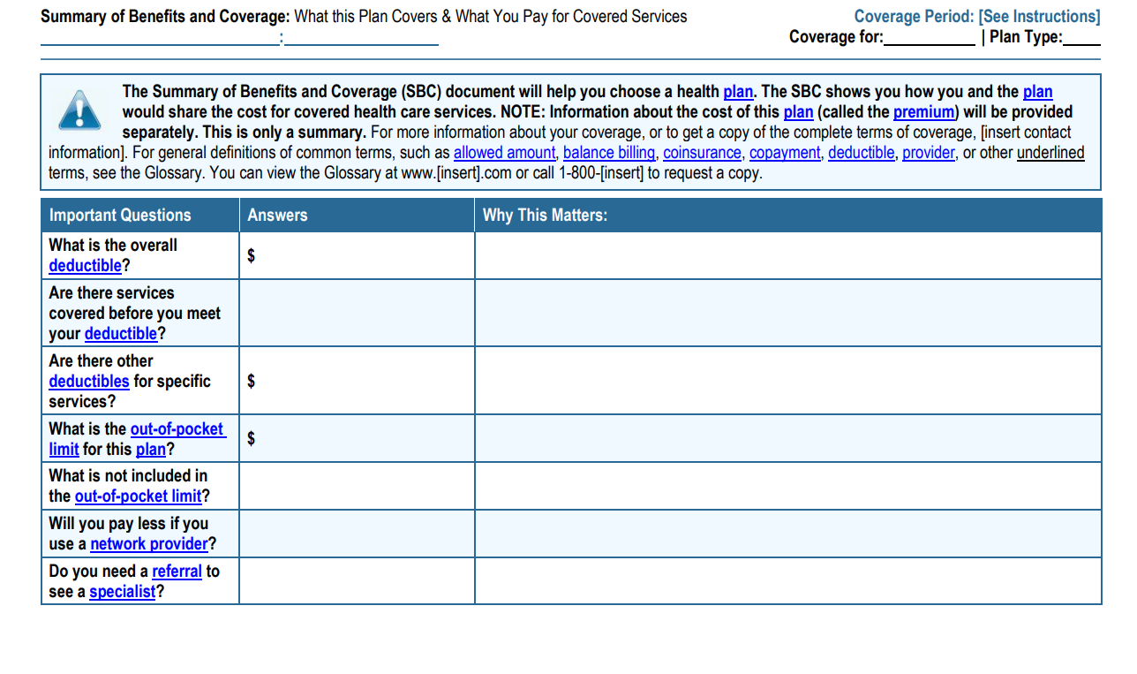
Summary of Benefits & Coverage (SBC)
Prescribed format
Required by the ACA
Short summary of benefits and coverage under the plan
Must be provided at enrollment, re-enrollment and upon request
Employer must provide 60 days’ advance notice of any material modifications of plan terms or coverage not reflected in the most recent SBC.
Common Compliance Issues
Failing to distribute timely
Information in SBC does not match SPD
Failing to provide updated SBC if benefits change mid-year

Slide 14
Affordable Care Act (ACA)
Annual ACA Reporting
 | Fully Insured < 50 FTEs | Fully Insured > 50 FTEs | Self-Funded < 50 FTEs | Self-Funded > 50 FTEs
Forms to Employees | 1095-B | 1095-B/1095 – C(Parts I and II Only) | 1095-B | 1095-C (Parts, I, II and III)
Issued by | Insurer | Insurer/Plan Sponsor | Plan Sponsor | Plan Sponsor
Forms to IRS | 1094-B and copies of 1095-B | 1094-B and copies of 1095-B 1095-C and copies of 1095-C | 1094-B and copies of 1095-B | 1094-C with copies of 1095-C
Filed by | Insurer | Insurer/Plan Sponsor | Plan Sponsor | Plan Sponsor
Note: Effective with the 2023 reporting due in 2024, electronic filing is mandatory if employer is filing 10 or more returns in aggregate (includes Forms W-2s, 1099s and 1095s.

Slide 15
Consolidated Appropriations Act (CAA) of 2021
Hospital Price Transparency
1/1/2021
Consolidated Appropriations Act (CAA)
1/1/2021
Transparency in Coverage (TICRA)
1/1/2022
1/1/2023
1/1/2024
Putting the “F” in Fiduciary
Lack of clarity before CAA for the role of Plan Sponsor as the Fiduciary under ERISA/PHSA
Contracts that restrict Plan Sponsors from full access to their data
Lack of transparency in pricing and benefit plan administration
Accountability for services provided
Need for more aggressive enforcement of the federal Mental Health Parity and Addiction Equity Act (MHPAEA)

Slide 16
Consolidated Appropriations Act (CAA) of 2021
Employer Fiduciary Responsibilities Across 4 Key Areas:
Removes gag clauses from service provider contracts on price and quality information
Establishes reporting requirements for prescription drugs and other medical spending
Requires the disclosure of direct and indirect compensation from all service providers
Requires annual Non-Quantitative Treatment Limitations (NQTL) analysis to demonstrate mental health parity

Slide 17
Gag Clause Attestation
Contracts with service providers cannot restrict (directly or indirectly) the Plan Sponsor’s access to provider-specific cost or quality of care information necessary to meet their fiduciary duties:
Operate the plan solely in the best interest of participants and beneficiaries
Verify that claims are properly processed and paid
Identify waste and fraud through comparative analytics
Verify that fees associated with the plan are reasonable
Provide participants and beneficiaries with access to information to make informed, cost-effective healthcare decisions
Plan Sponsors are required to attest annually starting 12/31/2023
Plan Sponsors should ensure they have documented their due diligence and can attest truthfully

Slide 18
Compensation Disclosure Requirement
To assist Plan Sponsor in fulfilling their fiduciary duty to ensure fees are “reasonable”
Must be provided to fiduciaries annually
Requires disclosure of service provider’s fiduciary status
Service provider reasonably expects to receive $1,000 or more in direct or indirect compensation
Development or implementation of plan design
Recordkeeping
Pharmacy benefit management
Medical management
Benefits administration
Wellness services
Transparency tools and vendors
Disease management
Compliance services
EAPs
Third-party administration
Other services listed in the statute

Slide 19
Prescription Drug Reporting (RxDC)
Requires Plan Sponsors to report certain prescription (and health care) spending to HHS, DOL and Treasury by June 1st annually:
Top 50 most frequently dispensed brand drugs
Annual amount spent by the top 50 most costly drugs
Amount spent for the top 50 most costly drugs in the prior year
Total health care spending for the year
Premiums and rebates
Annual reporting requirement allows Plan Sponsors to demonstrate their fiduciary duty by obtaining information necessary to evaluate the economic interest of participants and beneficiaries. Employers should document requests for the RxDC plan-level information.
The filing of the reports can be delegated to a third-party. However, the Plan Sponsor has the legal obligation to ensure timely, and complete filing.

Slide 20
MHPAEA Non-Quantitative Treatment Limitations (NQTL)
The CAA requires plan sponsors to analyze non-quantitative treatment limitations on mental health/substance abuse disorder (MH/SUD) benefits to show parity with medical and surgical care (Med/Surg):
Required as of 2/10/2021
NQTL must be performed annually and is extremely complex
NQTLs are limits on the scope or duration of treatment that are not expressed numerically (such as medical management standards, formulary design, step therapy protocols and methods for determining usual, customary and reasonable charges)
The law requires plans to make their NQTL comparative analysis available upon request by any government agency (CMS, HHS, DOL, state authorities)
*Does not apply to small self-funded plans of less than 50 employees
Fully-insured plans who rely on the insurance carrier to complete the analysis should verify compliance and retain a copy on file in case of an audit.
Self-funded plans will need to perform analysis using the DOL’s MHPAEA Self-Compliance Tool or contract with a third-party vendor.

Slide 21
MHPAEA Non-Quantitative Treatment Limitations (NQTL)
The Departments of Labor, Health and Human Services and 2022 Report to Congress
NONE of the comparative analyses initially reviewed to date have been sufficient (156 letters were issued)
Deficiencies identified:
  Failed to identify the benefits, classifications or plan terms to which NQTL applies
  Failed to describe in sufficient detail how the NQTL was designed or how it is applied in practice to MH/SUD benefits and Med/Surg benefits
  Failed to analyze in sufficient detail the stringency with which factors, sources, and evidentiary standards are applied
  Failed to demonstrate parity compliance of NQTLs as written and in operation

Slide 22
MHPAEA Non-Quantitative Treatment Limitations (NQTL)
Potential Red Flags
These types of plan provisions should be investigated to determine if they also apply to medical/surgical benefits and if they are being applied in a manner that complies with MHPEA.
Preauthorization and pre-service notification requirements
Fail-first protocols
Probability of improvement
Written treatment plan required
Patient non-compliance
Residential treatment limits
Geographical limitations
Licensure requirements

Slide 23
MHPAEA Non-Quantitative Treatment Limitations (NQTL)
July 2023, Agencies proposed new MHPEA regulations to bolster mental health parity rules and solidify NQTL comparative analysis
Confirms eating disorders and autism spectrum disorder (ASD) are considered mental health conditions
Adds additional requirements for plans that impose NQTLs to MH/SUD benefits
Provides additional details on form and content of the NQTL comparative analysis
N.R. v. Raytheon Co. – Appellate court reinstates class action lawsuit for plan’s denial of speech therapy for Autism Spectrum Disorder

Slide 24
Miscellaneous
Section 125
Cafeteria Plan Document if withholding employee premiums pre-tax through payroll
FMLA
FMLA Poster
Annual nondiscrimination testing (Safe Harbor for POP Plans)
Eligibility Notice
Rights & Responsibilities Notice
General Notice
Annual CMS Reporting
Online submission, due within 60 days of the beginning of the plan year
Annual 105(h) Nondiscrimination Testing
Applies to elf-funded plans including HRAs

Slide 25
Minimize Risk
Important to know how to prepare for (and potentially avoid) an audit
Best time to analyze whether you are ready for an audit is before the DOL knows on your door
Understand common audit triggers and the audit process
Confirm compliance with applicable law
Maintain documents to show compliance

Slide 26

Lauren Johnson
Questions?
www.jbcpros.com
laurenj@jbcpros.com
(859) 277-4291

